Slide 1
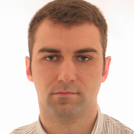
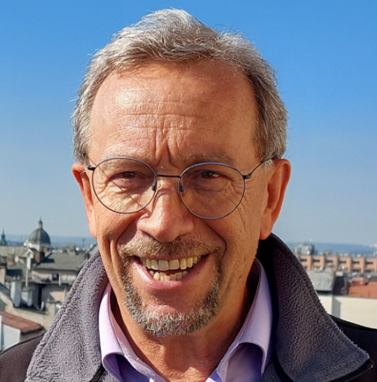
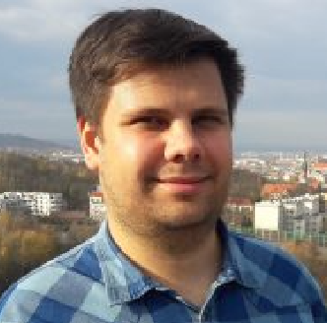
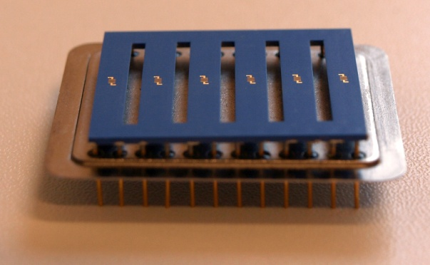
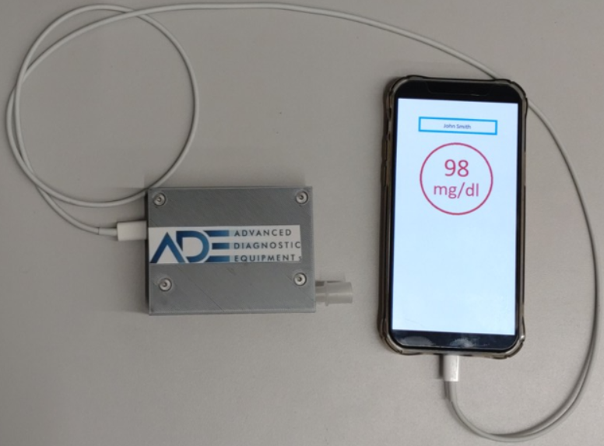
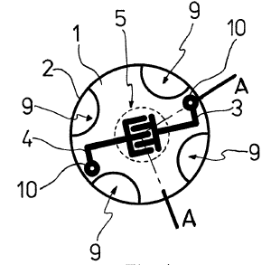
16th International Invention and Innovation Show Katowice 24-25 May 2023
Breath biomarkers data conversion, portable device for analyte content and biomarker concentration analisis and computer code product
INVENTORS
APPLICANT
INVENTORS
Artur
Rydosz
What for?
HEALTH
P.443399
Reg. 2023-01-02
Konstanty W.
Marszalek
for glucose level measurements of
diabetes with:no pain !
no blood !
no stress !
for kids, older people, anyone
It is necessary only to analyze your breath and results could be shown or send to your doctor
Dominik
Grochala
PATENT DESIGN
The object of the invention is a computer
implemented method of converting respiratory
biomarker data into a signal indicating the need
for a patient to take medication, as well a
a portable device for implementing the method
and a computer program product
.
DOCUMENTS
Device components:
Awards & Patents Granted
IFIA Award Hong Kong 2017
GOLD MEDAL IWIS 2017
GOLD MEDAL Hong Kong 2017
GOLD MEDAL Bangkok 2018
GOLD MEDAL Skopje 2018
PLATINUM MEDAL IWIS 2018
GOLD MEDAL Nurnberg 2018
GOLD MEDAL Skopje 2018
GOLD MEDAL Seul 2018
GOLD MEDAL Bangkok 2019
PLATINUM Medal Paris 2022
WIIPA Avard Paris 2022
Bulgarian Innovators Soc. Award 2017
Chinese Innovators Soc. Award 2017
Thailand NRC Award 2017, 2018
British Innovators Soc. Award 2018
Minister of Science &HE Award 2018
Microconcentrator of gases PL 225138 B1
Integrated gas sensor matrix PL 229704 B1
Mouthpiece connector PL 69 839 Y1
Preconcentrator of gas samples PL 69 938 Y1
Diabetes diagnosis from breath analisis
to portable
device
single
sensor
via sensor
matrix
INVENTION DESCRIPTION
Analysis of diabets markers concentration (extremaly low level ppm or less) in human breath gives us data for glucose in blood content determination. Idea is simple but device is more sofisticated and data are analysed by artificial inteligence (AI) unit and could be transfered to patient’s mobile, his doctor or medical center by LVB (Low Voltage Bluetooth)
ACKNOWLEDGEMENTS
The authors would like to thanks Minister of Education & Science for financial Support
within Programme‚ „Science for Society” –no NdS/529018/2021 (2022-2024)4

