Slide 1
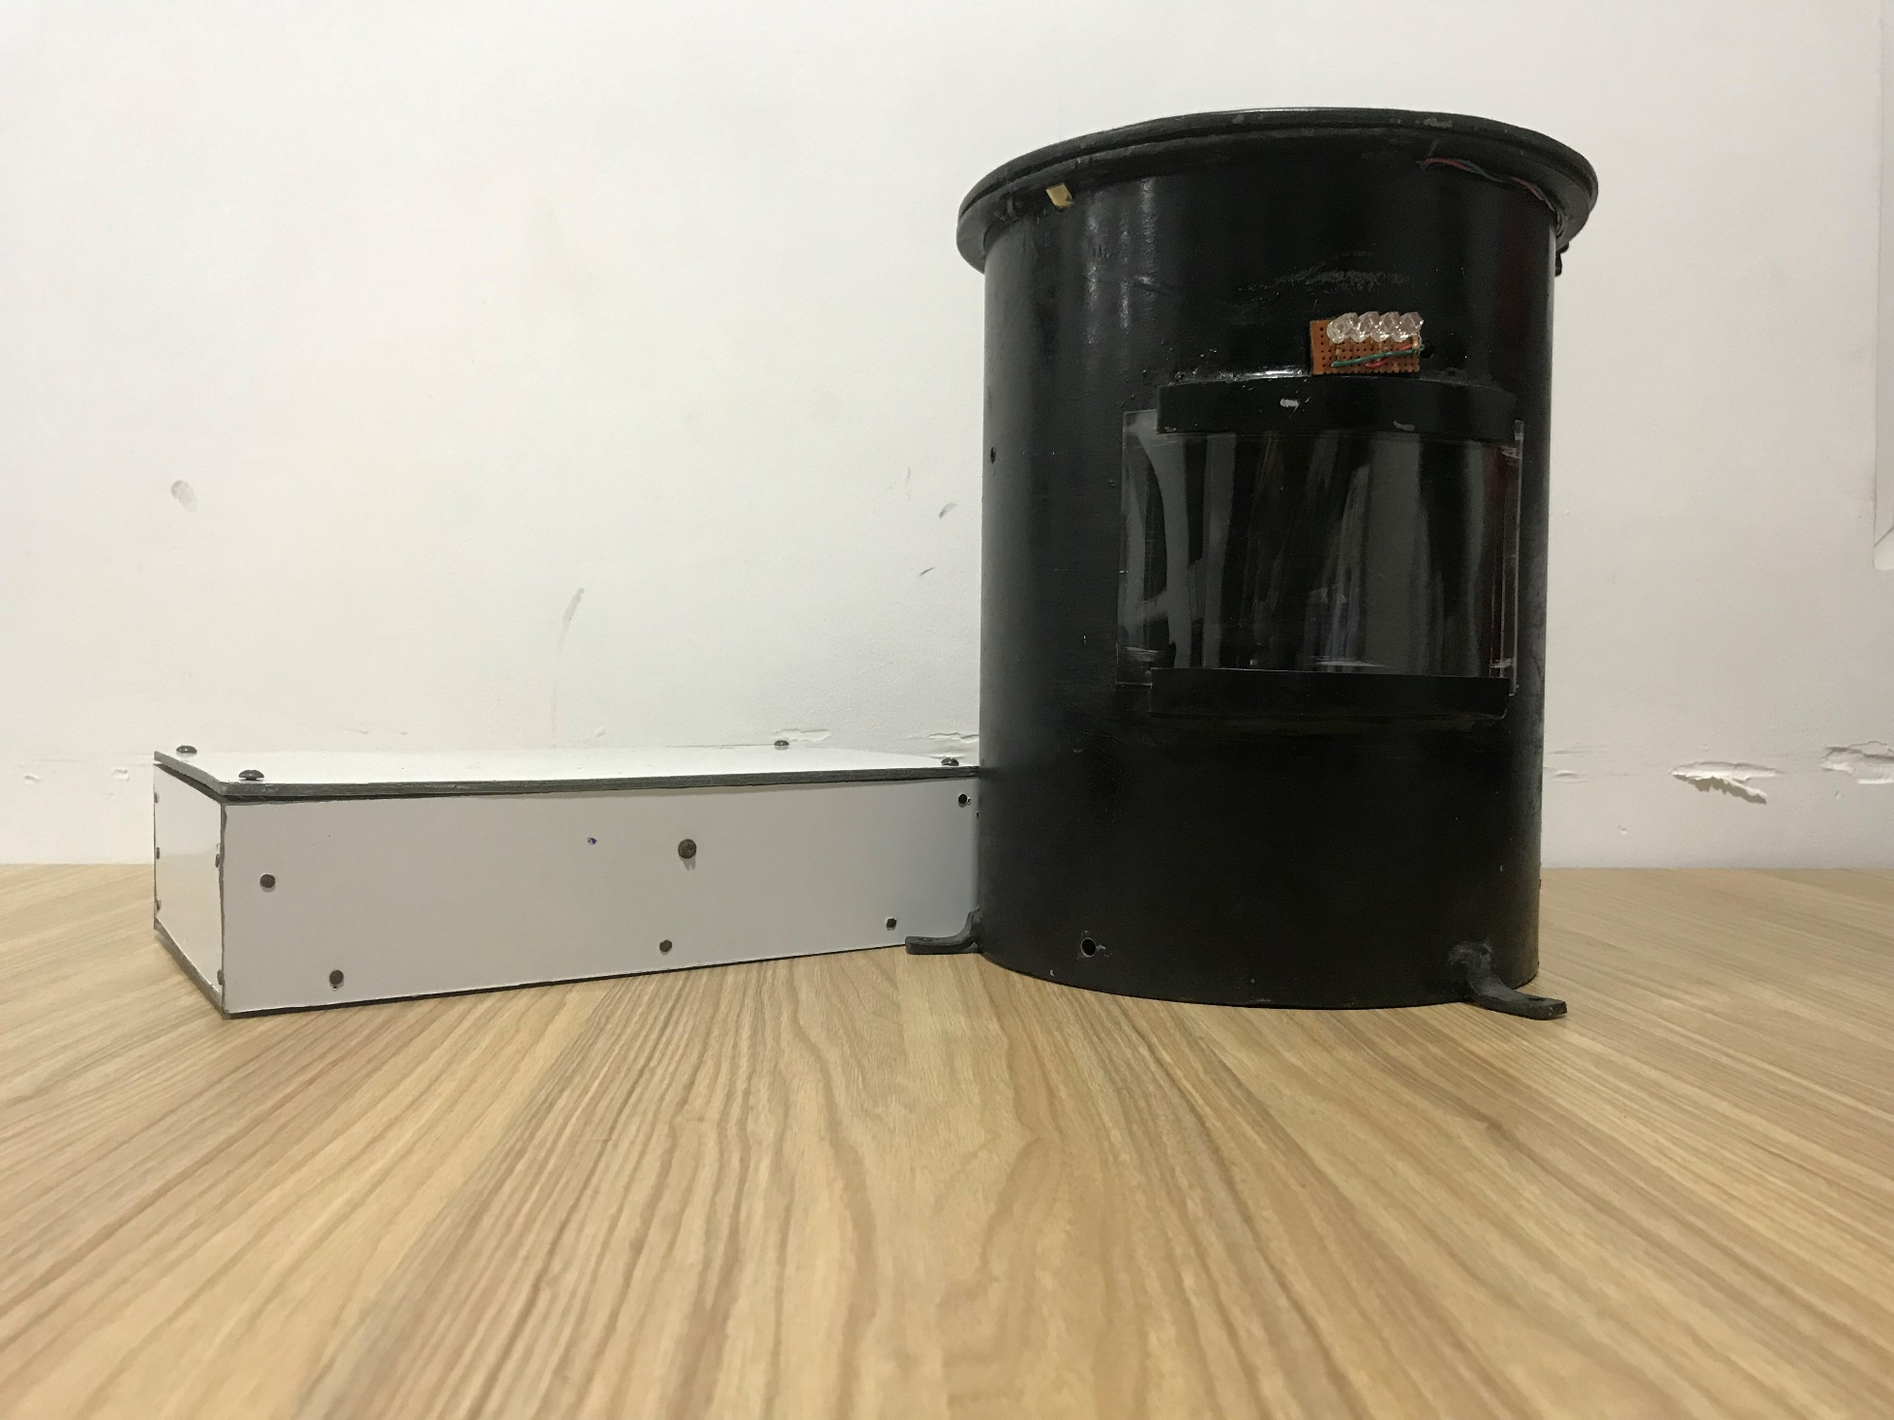
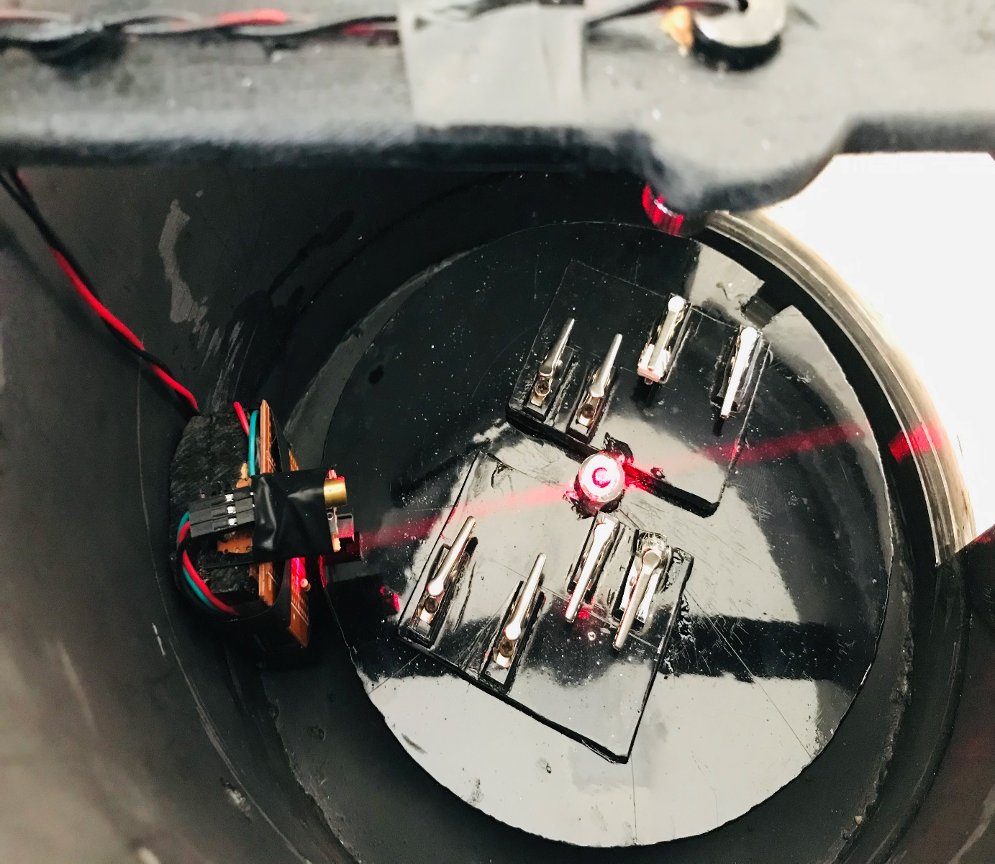
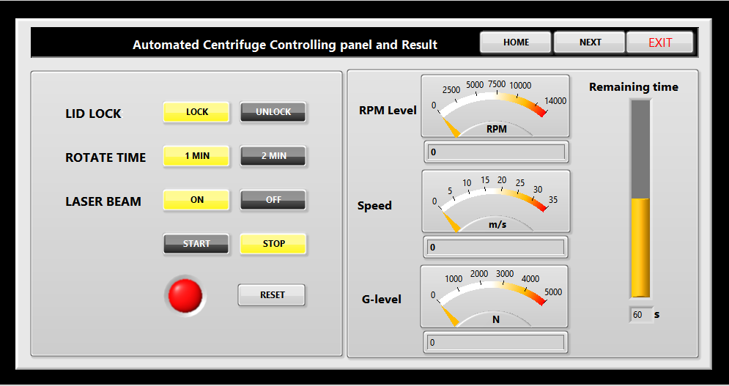
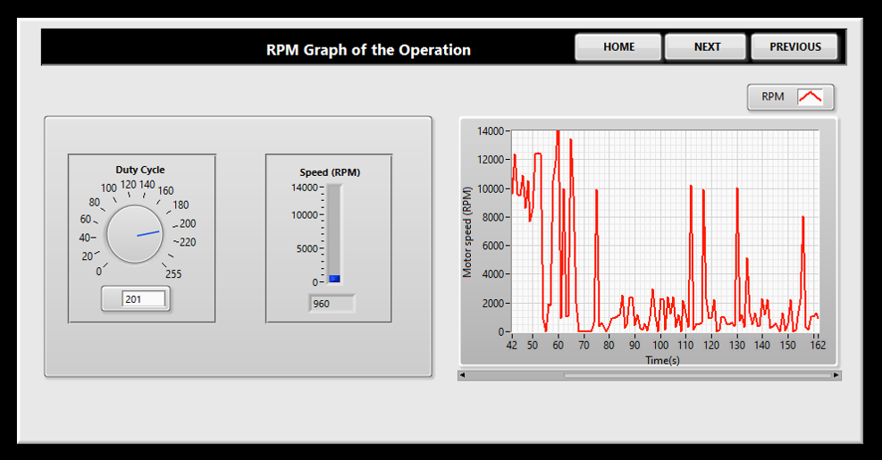
Bachelor of Science (Honors) in Engineering in Electronics and Telecommunication
REAL TIME DURABILITY DESTRUCTIVE MONITORING SYSTEM FOR SEMICONDUCTOR INDUSTRY
Asintha Jayasekara
Malsha Ruwanpathirana
Supervisor : Mr. Sachinda Ekanayake
AIMS AND OBJECTIVES
RESULTS AND ANALYSIS
Build a Real time device separation, observation system using centrifuge mechanism that can determine the condition of electronic components and devices.
To evaluate the reliability of electronic components.
To study and observe testing conditions.
PROBLEM STATEMENT
Some electronic components are unable to check before using it. (Ex: IC) This real time operation help to check the quality of electronic components before releasing it to the market and create efficiencies and high-quality market by giving the device confidentially.
PROJECT METHODOLOGY
The use of centrifugation mechanism the test was done to evaluate the reliability of electronics components in semiconductor industry.
LabVIEW program is used to control the real time operation.
CONCLUSION
By using centrifugation mechanism this project proposed a solution to determine faults in the electronic components during manufacturing. While modeling the centrifuge, observed the effect on gravitational force and analysis behavior of semiconductors. The data is also stored with the help of a MS-SQL database.
PROBLEMS AND CHALLENGES
LabVIEW software is new to us. So, we learned it from the beginning.
Requirement of several pre-testing in order to select the best component based on the sensitivity.
OUTCOMES
KEY REFERENCES
Centrifuge modeling is a strong method for physical modeling of reinforced slopes, with the added benefit of observing the slopes' failure mechanisms. It is necessary to test the model in a gravitational field N times bigger than that of the prototype structure in order to duplicate the gravity-induced stresses of the prototype structure in a geometrically 1/N reduced model. We employed this mechanism in this research and calculated the G-level based on it.
[1] J.L. Roshala,"Device for loading component into a centrifuge to be tested," 11 August 1987. [Online]. Available:https://www.freepatentsonline.com/4685853.html
[2] S. Parmar, "Monitoring and Control of Speed of DC Motor using LabVIEW Environment,"12 March2018.[Online].Available:https://www.ijream.org/papers/IJREAMV03I113535.pdf.

