Slide 1
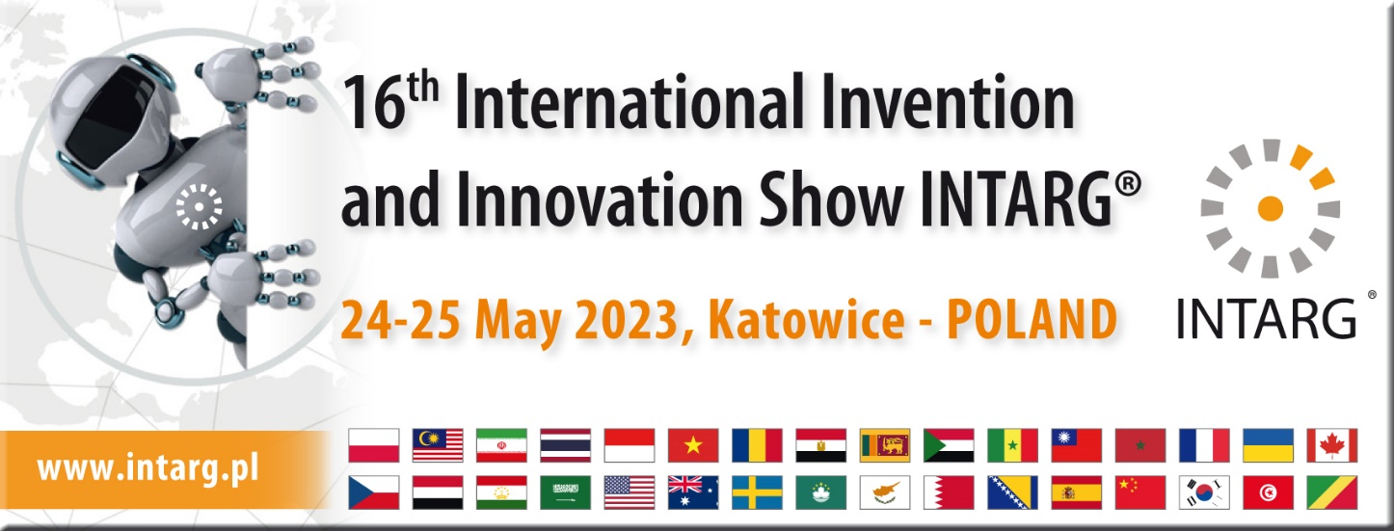
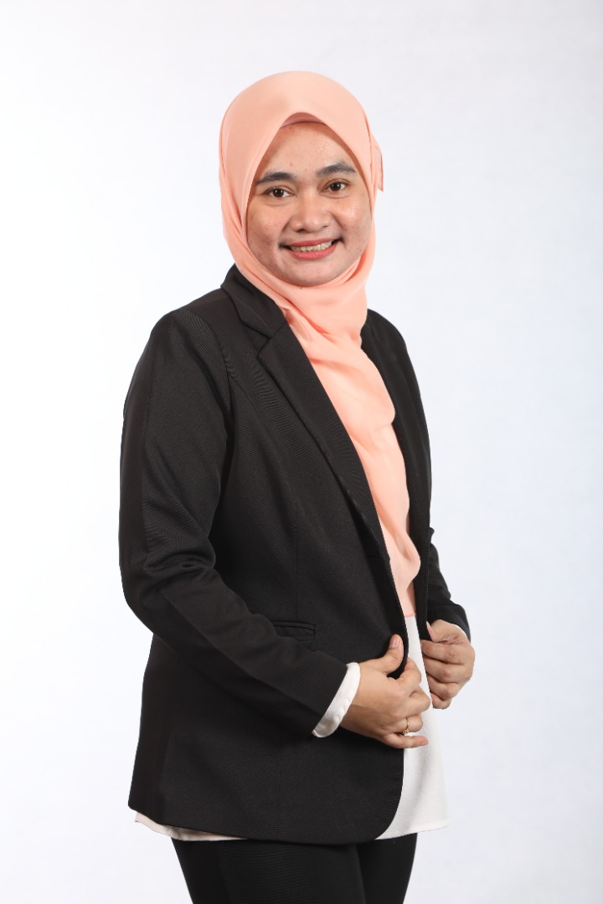
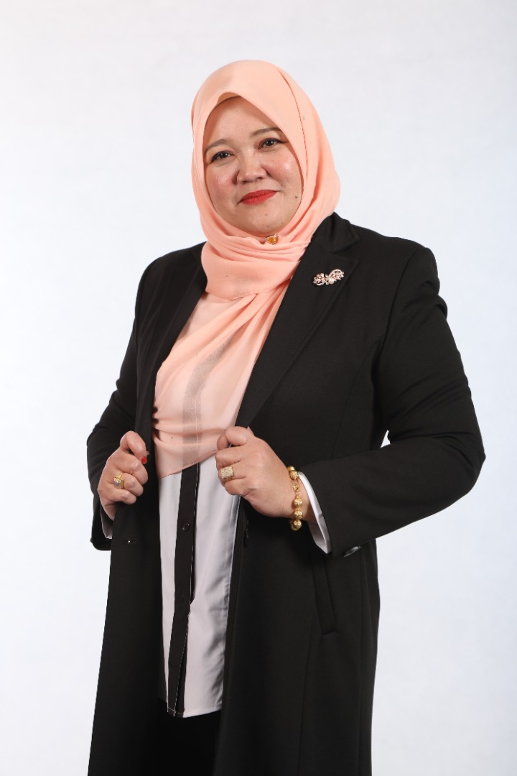
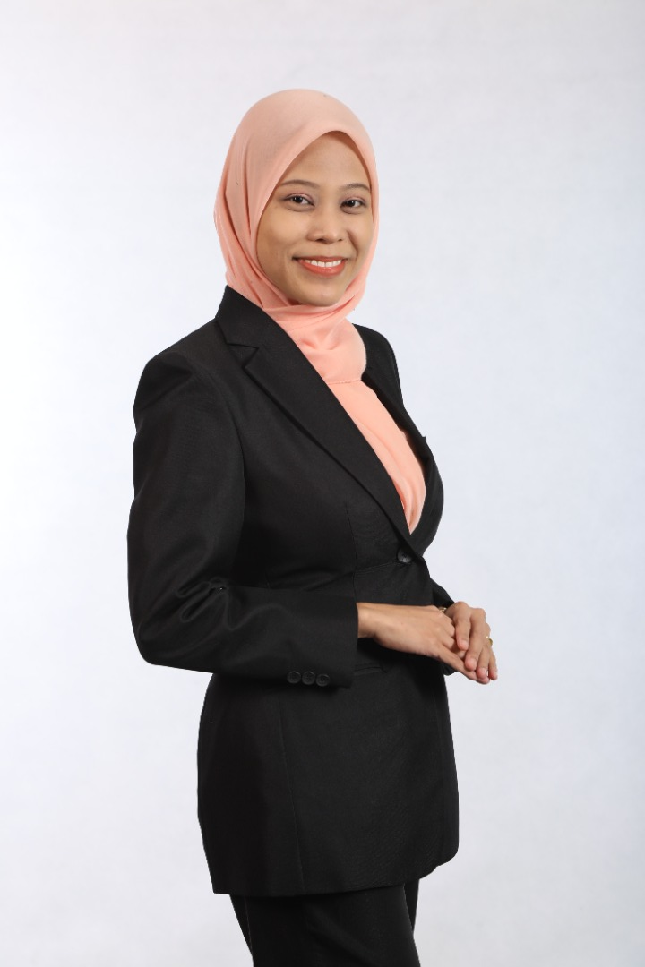
BIBLIOTHERAPY TECHNIQUES FOR SELF HEALING
INNOVATION & CREATIVE TECHNOLOGY DIVISION (BITK)

Slide 2
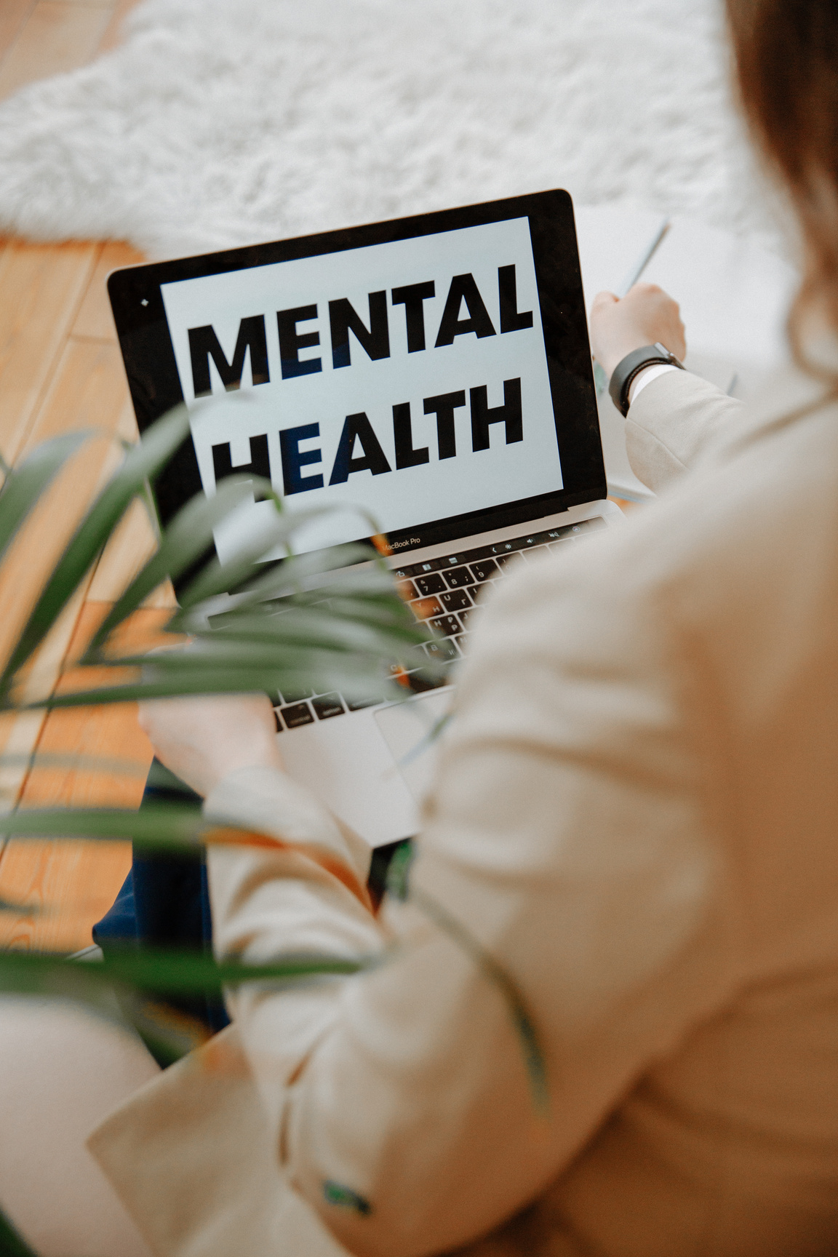
Major depressive disorder is affecting more than 10% of populations worldwide, and the World Health Organization anticipated that it will be the first health problem in 2030 (Gu et al., 2018). Over 450 million people around the world are affected by mental disorders. According to the World Health Organization (WHO), 1 in 4 people experiences mental illness at some point in their lives
In Malaysia, 1 in 3 citizens suffers from mental health problems, with the prevalence being highest among low-income individuals and those between the ages of 16 and 19. According to the National Health and Morbidity Survey (NHMS) that the Ministry of Health (MOH) performed in 2015, people aged 16 and older are 29.2% more likely to experience mental health issues. In March 2021 ASEAN Today article revealed that Malaysia is experiencing an increase in mental health problems, which the existence of COVID-19 may be exacerbating. It lists the main causes of anxiety, stress, and depression as being social isolation, a precarious financial situation, and the loss of a loved one
Mental illness is the second-biggest health problem affecting Malaysians after heart diseases since 2020. Community-based strategy is recommended to reduce the stigma associated with mental illness. Sharing mutual concern on these issues, as a community strategy in the library, our innovation group came out with an innovation - BIBLIOTHERAPY TECHNIQUES FOR SELF HEALING

Slide 3
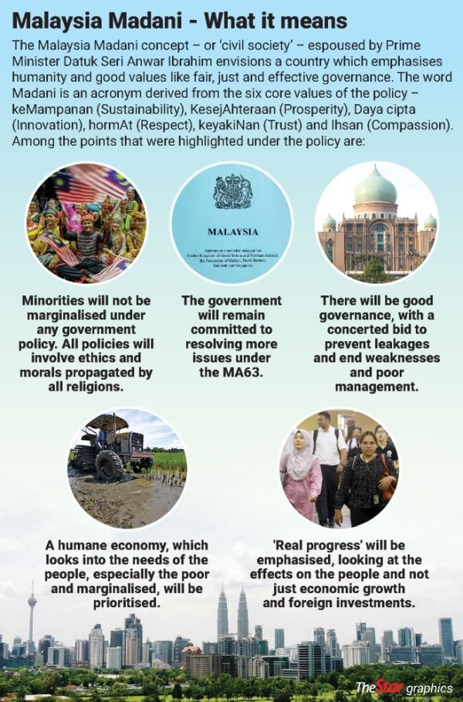
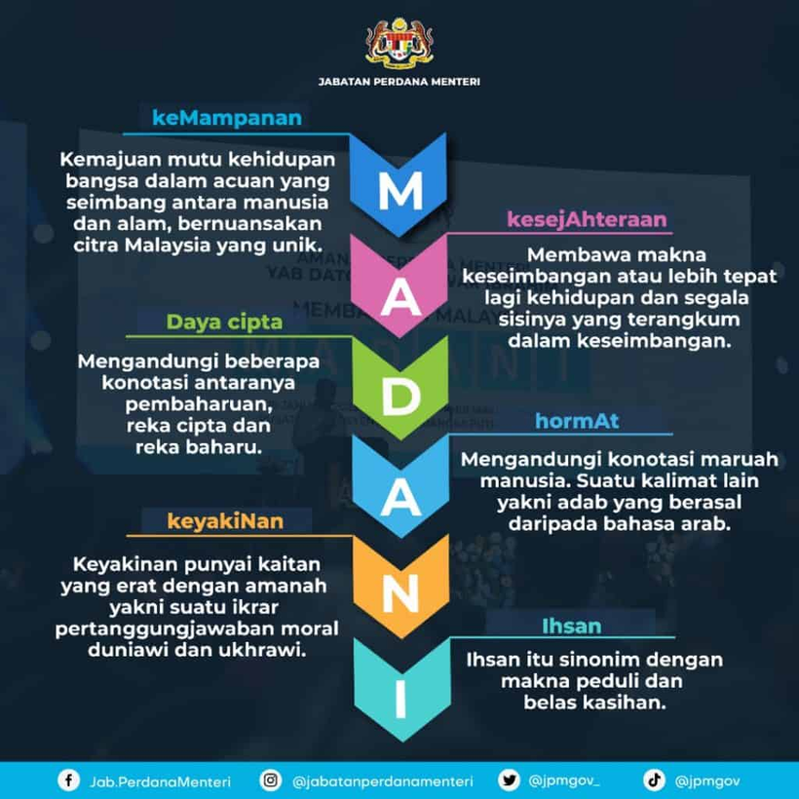
On 19 January 2023, Prime Minister Datuk Seri
Anwar Ibrahim announced a policy framework to
re-establish the country as a prosperous and respected country. BIBLIOTHERAPY TECHNIQUES FOR SELF HEALING is relevant with “Malaysia MADANI” Themed 'Building a Civilized Malaysia', the concept introduced by Datuk Seri Anwar Ibrahim rests on six main pillars as follows:
Sustainability
Prosperity
Innovation
Respect
Trust
Compassion

Slide 4
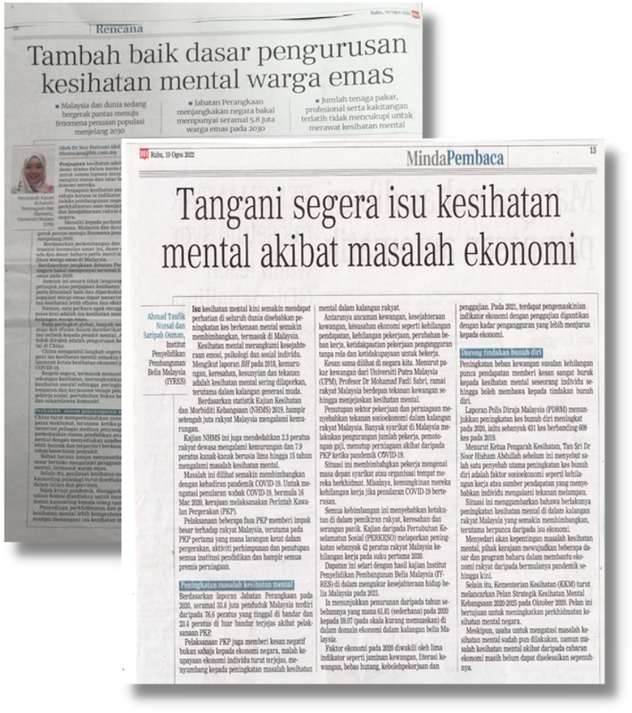
POINT OF VIEW (POV) OF MENTAL HEALTH IN MARA
Covid-19 pandemic that hits the country in 2020 contribute to worse mental health issues. Civil servants are also affected by this situation that is reflected in their workplace.
Mental health issues faced in MARA, are also faced in other organizations and it is also a global problem. Therefore, our department begin a proactive steps with a Bibliotherapy Project.

Slide 5
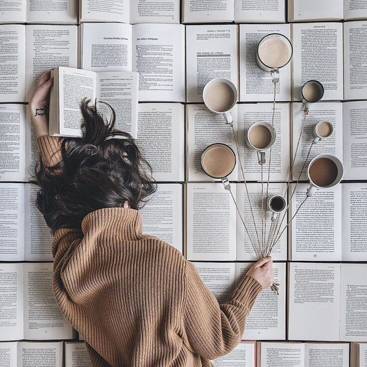
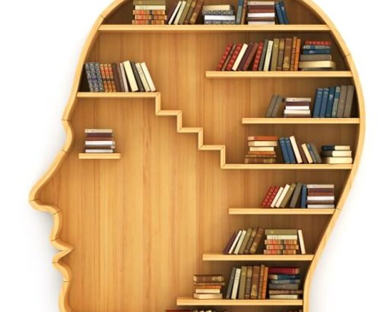
WHAT IS BIBLIOTHERAPY?
• Bibliotherapy is a form of innovation in psychological therapy that focuses on leveraging the power of stories to heal. Its power lies in the relationship that is formed between the reader and the writing and the reflection of the thoughts, feelings, observations and lessons that the writing provokes, through a daily journaling practice or a counselling session with a mental health professional or a bibliotherapist/ librarian (Bijal 2022).
• Bibliotherapy also known to treat depression as well as more moderate to mild issues such as stress, anxiety disorders, eating disorders and low self-esteem. It has also been known to promote psychological happiness, emotional relief and general mental well-being while also enabling personal development and self-discovery (Bijal, 2020).
• Bibliotherapy is a useful treatment for the prevention and treatment of mental disorders and has led to the formation of creative treatment. Bibliotherapy is a form of therapy that involves reading materials (writing, reading & listening) to improve mental well-being. Bibliotherapy aims to bridge this gap by using literature in order to help people to improve life. (PERBIMA)

Slide 6
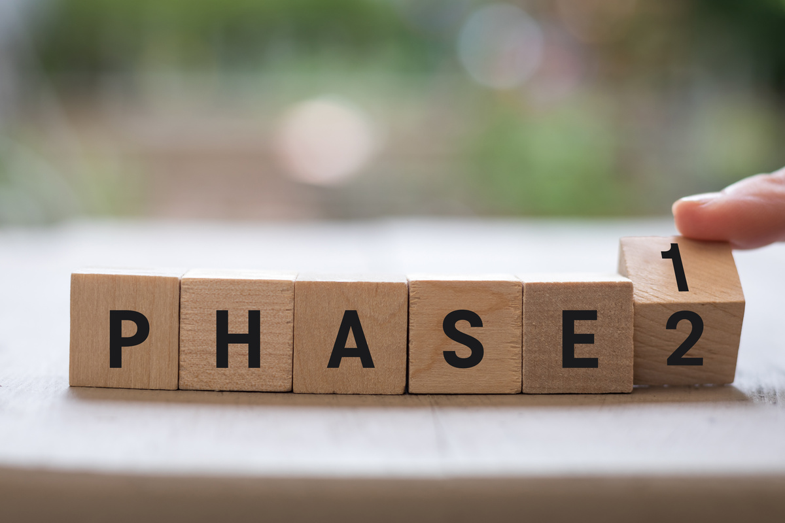
TYPES AND PHASES IN BIBLIOTHERAPY
There are 3 types of bibliotherapy in MARA: -
Writing
Reading
Listening
Three phases of bibliotherapy
• Identification: identify problems and appropriate materials
• Catharsis: emotional or feeling relief
• Vision: understand something that is happening deeply
(Rafidah PERBIMA, 2022)

Slide 7
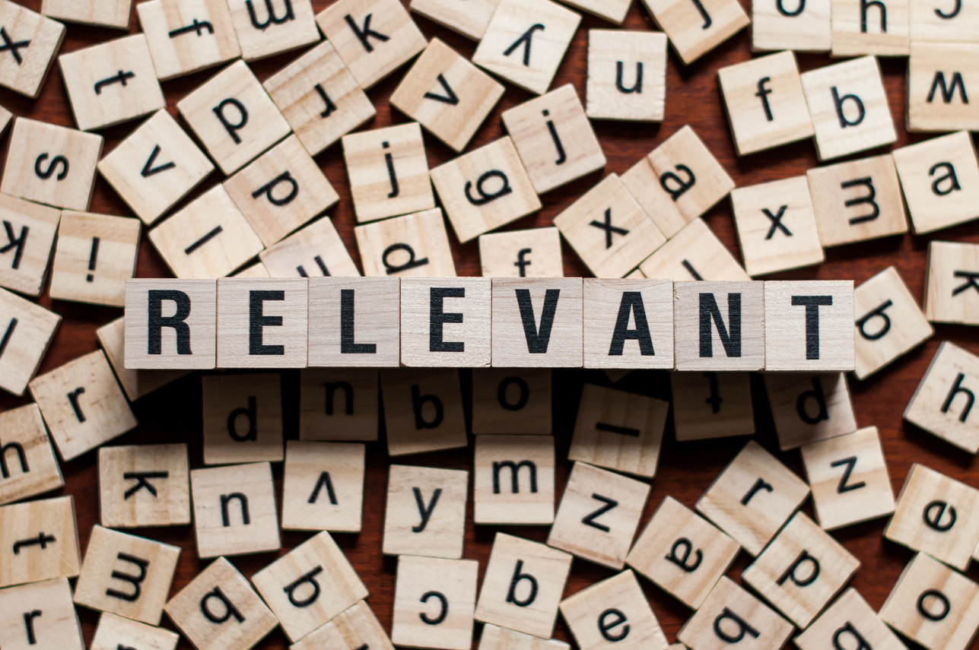
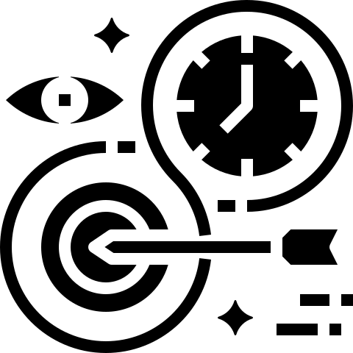
RELEVANCY OF BIBLIOTHERAPY IN MARA
MARA's bibliotherapy project supports MARA Human Resource vision, which is "To be the driving force and trigger for the existence of MARA staff to be competent, professional and trustworthy human capital in line with the demands of MARA's direction"

Slide 8
PROBLEM STATEMENT
Mental and Emotional Self-Healing Among Staffs Using MARA Bibliotherapy Technique for better productivity

Slide 9
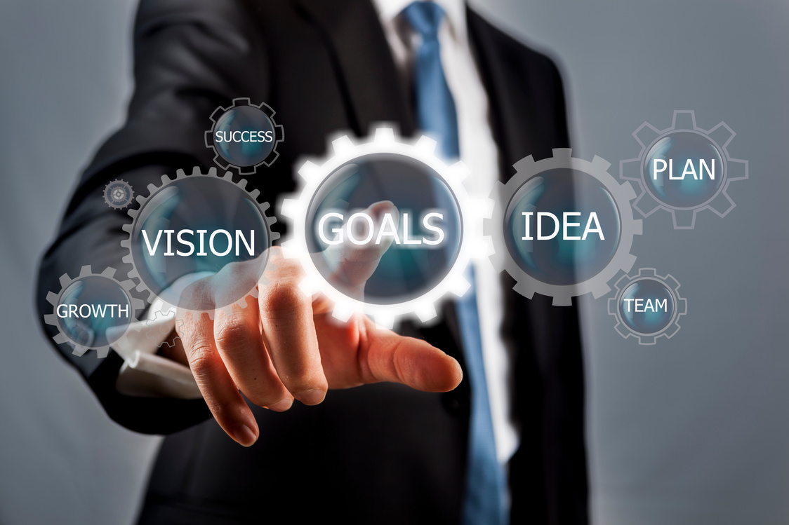
OBJECTIVES
1. To reduce depression level among employees
2. To reduce anxiety level among employees
3. To reduce stress level among employees
4. To reduce operational cost
5. To reduce manpower

Slide 10
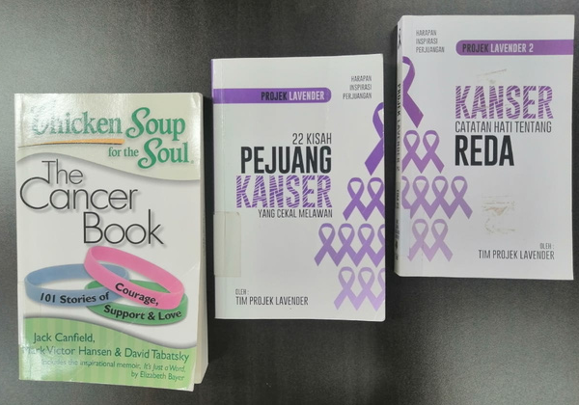
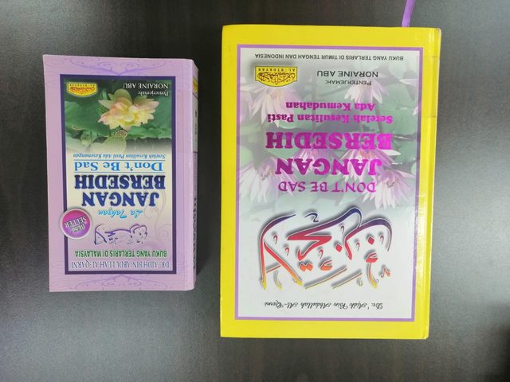
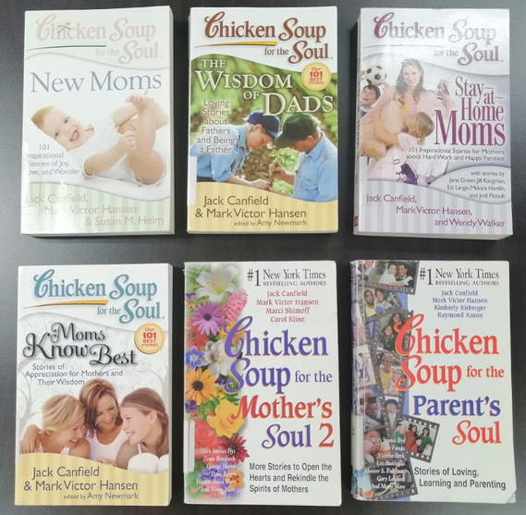
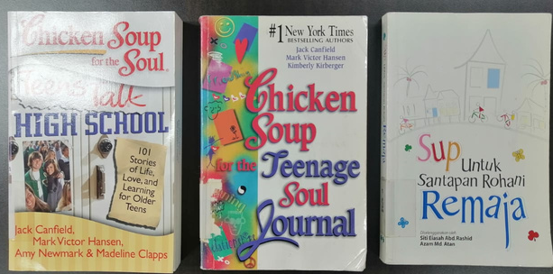
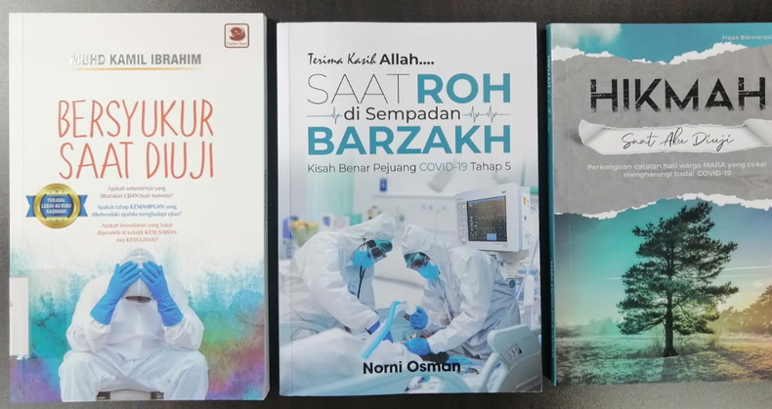
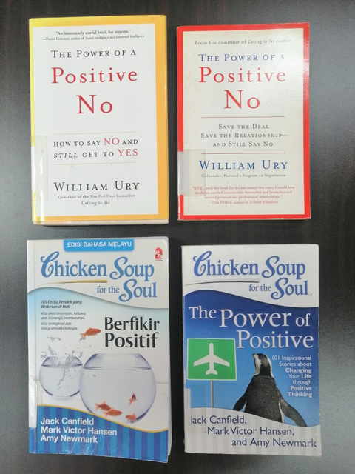
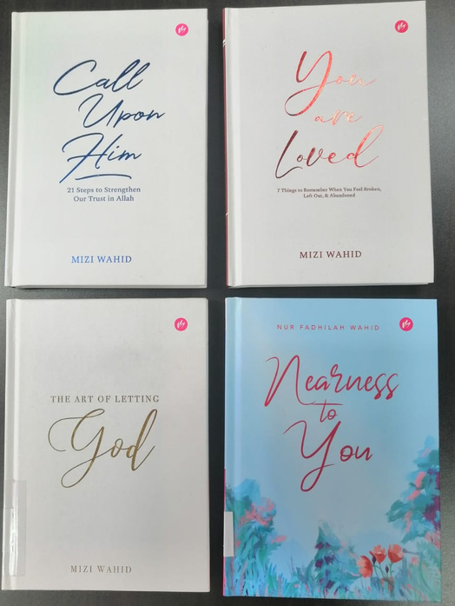
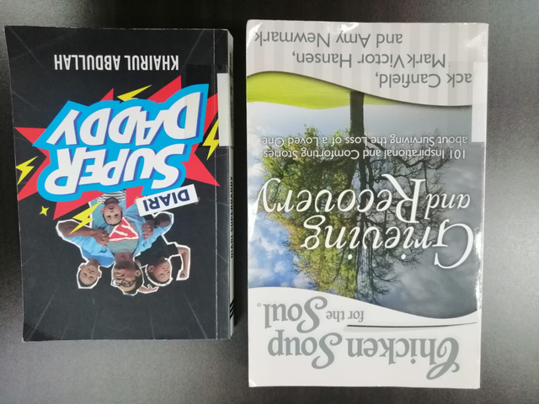
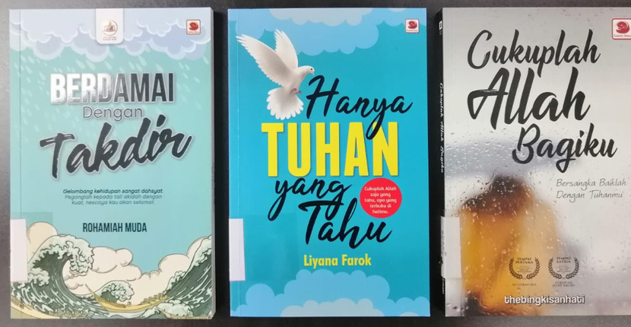
MARA Knowledge center provides books for mental well-being according to specific themes
Heart Recovery
Family Issues
Cancer Survivor
Teenager Issues
Pandemic & Disease
Self-Esteem
Peace of Mind
Lost Loved One
Acceptance & Healing

Slide 11
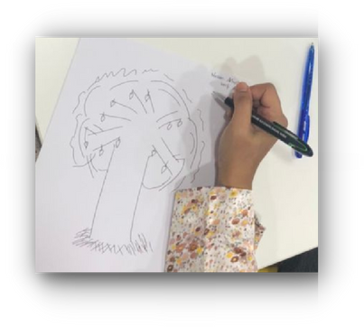
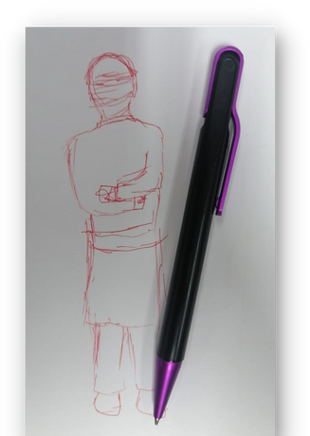
MARA
Flow of Process
Biliotherapy Tehchnique
1 Screening HTP test
Screening Test
DRAWING THERAPY
Screening personality & emotional trait to:
1) Normal case will join reading therapy
2) Normal & Medium case will join writing therapy
3)Serious case for close monitoring by Therapist
1

Slide 12
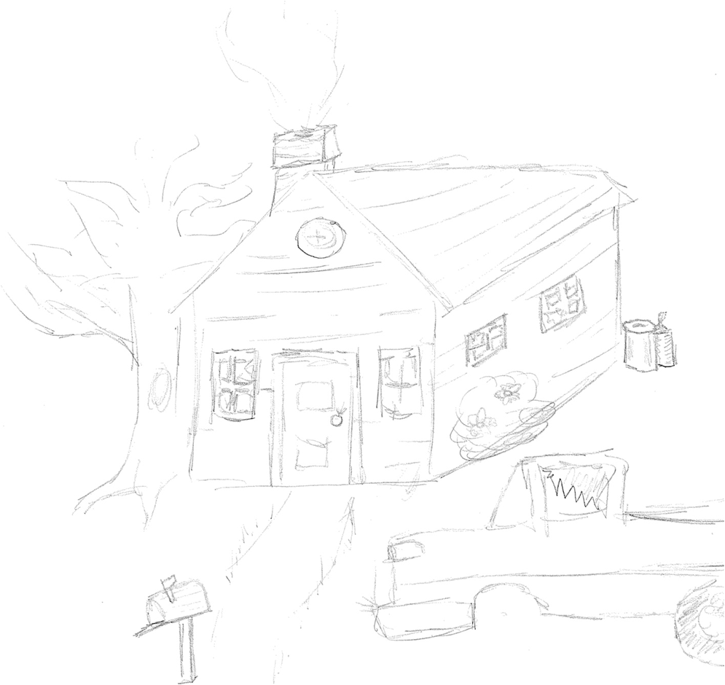
WHAT IS
HOUSE-TREE-PERSON DRAWING TEST?
The house-tree-person test (HTP) is a projective test intended to
to create a picture of the person’s cognitive, emotional, and social functioning
The house-tree-person test is used by counsellors and educators for staffs and students.
HTP drawing is one kind of mental projective test , which refers to the free expression of thoughts that can then be interpreted to reflect inside thoughts of the subject (Wang et al., 2014).
The subject’s responses are then analyzed in various ways, such as what was said, the time taken to respond, which aspect of the drawing was focused, etc.
The results are based on psychodynamic interpretation of the details of the drawing, such as size, shape, complexity of the house-tree-person . The HTP-drawing tests have been used in emotional test, psychological screening, and post-disaster relief (Chen and Xu, 2008b), and have been proved to be a useful tool for the diagnosis of emotional disorders (Inadomi et al., 2003).

Slide 13
HOUSE TREE PERSON (HTP)
METHOD
Each participant was provided with 3 sheets of A4 papers and a pen
Participants were instructed to draw a tree following these four rules:
The tree-drawing test is not a test of drawing technique and the drawing does not need to be aesthetically pleasant
The tree does not need to appear life-like *Before you draw a tree, close your eyes and meditate for half a minute
Draw the tree that appears in the meditation. If there is no tree in the meditation, open your eyes and draw the tree that is most appealing to you;
After completing the drawing, write down your nick name at the right top of the paper
Repeat this process with drawing a house and a person

Slide 14
DEFINITION OF ELEMENT HOUSE OF TREE (HTP)
Drawing a house The house is considered being the expression of the respondent’s family relations and family values. The roof stands for the intellectual side and spiritual life of the individual. The walls might be related to the test taker’s character strength. The doors and windows represent the individual’s relationship to the outside world and the level of social integration.
Drawing a person The person is a symbolic representation of the ideal self and one’s social interactions. The head symbolizes intelligence, communication, and imagination. The eyes indicate the perception of the world. The hands give information about affectivity and aggressiveness.
Drawing a tree The tree is thought to suggest the deepest, unconscious aspects of the personality. The branches may show the degree of social connectedness. A tree with no branches indicates, for instance, that the person has little contact with others. The trunk is often seen as a representation of inner strength. The tree crown stands for ideas, thoughts, and self-concept. The canopy was suggested to reflect mainly the conscious emotional state of the subjects (Kaneda et al., 2010). It is suggested that the canopy expresses the subjects’ understanding
The canopy was suggested to reflect mainly the conscious emotional state of the subjects (Kaneda et al., 2010). It is suggested that the canopy expresses the subjects’ understanding and structure of his or her intimate relationship with family, relatives, and others. In addition, the canopy also describes the spiritual and emotional intellectual development of the subject, scope of interest, goals and aspirations, and their overall satisfaction (Kaneda et al., 2010).

Slide 15
In conclusion:
1. 72% subjects indicates individuals with better development, high mental energy levels, sufficient self-confidence and motivated.
2. 4% subjects shows the symptoms of depression, helplessness, feelings of uselessness, lack of interest, loss of interest, and pessimism. And it has been suggested that the values concerning the size of the tree, such as the height and width of the whole tree, height and width of the crown, and number of occupied areas (of the paper), were significantly lower in the depression (Murayama et al., 2016).
3. 12% subjects found to have depression (Yan and Chen, 2011; Hu and Chen, 2012) that reflect their personality traits, including depressed motivation, low self-esteem, lacking of vitality, lacking of self-control, dependence, withdrawal, disengagement, and self-destruction (Ji, 2011).
4. 16% subjects shows low effectivity & aggressiveness
Screening results
72% or 18 subjects drew tall tree.
4 % or 1 person (sample A10) draw very small size house, tree and a person with hands tight at the back (as shown in picture below). Sample A10 drew small canopy area, canopy height, canopy width, trunk width, and total area of trees.
12% or 3 person drew short and small trunk.
16% or 4 person drew a person without hands.

Slide 16
Data collected helps us to understand their emotions and prescribe the suitable bibliotherapy book for them to read. We also encourage them to express their feelings through writing by joining our Bibliotherapy writing workshop organized yearly. Writing is also a form of therapy to help them in self healing.
For serious case (sample A10) we make a report to the Counsellor in BSM for close monitoring and further actions

Slide 17
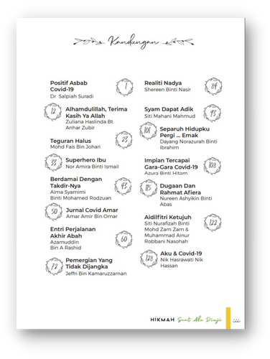
Step in bibliotherapy writing in MARA
Writing Workshop I
300++
participantS
in mara
Open training through online
Bibliotherapy Writing Workshop I
2
20 STORIES
Selection of the best stories to be published in Bibliotherapy Book
Selected
Work
3
20 WRITERS
The selected writers will join
Bibliotherapy Writing Workshop II
for writing skills enhancement
Writing Workshop II
4

Slide 18
1
BIBLIOTHERAPY IN WRITING
For individuals who have experienced a traumatic or extremely stressful event, expressive writing guided purposefully toward specific topics can have a significant healing effect. In fact, participants in a study who wrote about their most traumatic experiences for 15 minutes, four days in a row, experienced better health outcomes up to four months than those who were instructed to write about neutral topics (Baikie & Wilhelm, 2005)

Slide 19
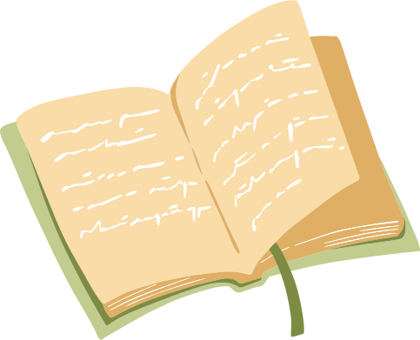
BIBLIOTHERAPY WRITING METHOD
1. MARA staff share their experiences in facing challenges positively in self-written short stories (anecdotes). All three elements in Bibliotherapy
Identification,
Catharsis (emotional release)
Insight are included in the writing.
Surprisingly the writer himself/herself felt release after sharing the stories.
2.The bibliotherapy book is then read bv other staffs as initiatives to detect depression, anxiety and stress levels.
3. All 35 samples were tested with pre and post test using the DASS21 (Depression, Anxiety, Stress Scale) to measure the negative emotional states conducted by Dr Salpiah our counselor.
4. Samples are then screened using DASS-21 and high cases of depression anxiety and stress wine sent to Human Resources Department for close monitoring

Slide 20
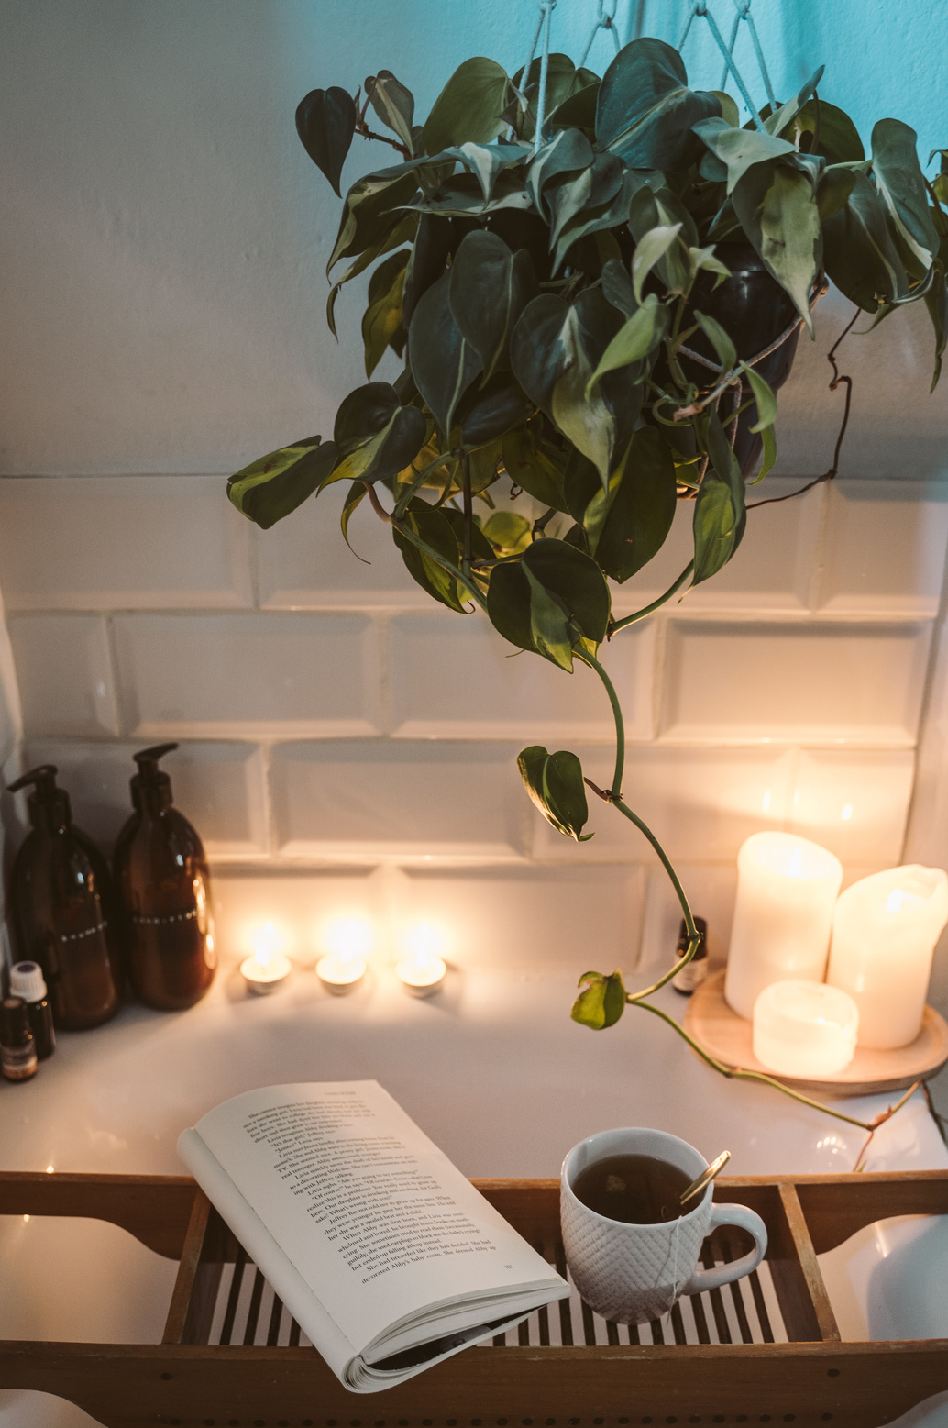
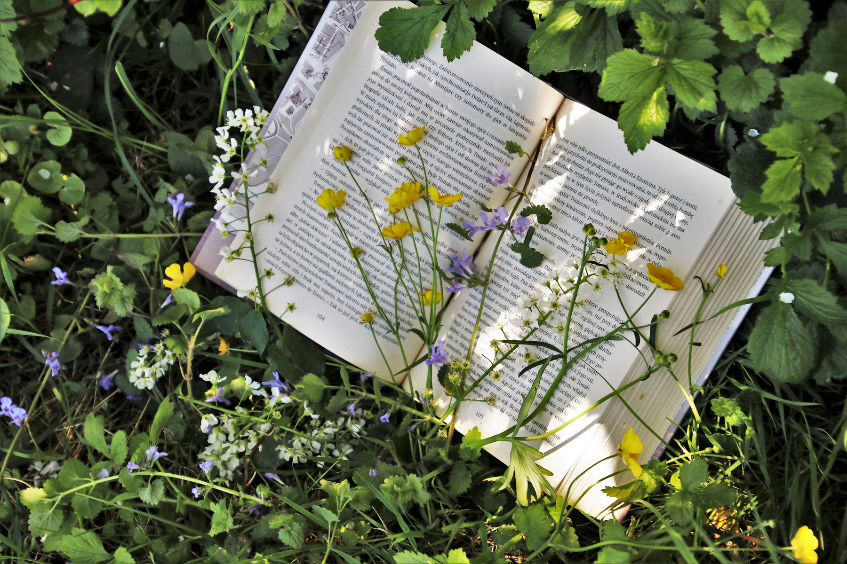
2
BIBLIOTHERAPY IN READING
Bibliotherapy is the process in which a book is prescribed to a person experiencing a real-world problem. Bibliotherapy is also now seen as a healthy way for a reader to release emotions, and build empathy for the character who faces a similar dilemma. Scientists are now studying how bibliotherapy can be used to increase mental well-being. Discover Magazine (2022).
Reading can have a positive effect on your mind. It opens your mind and consciousness to the different possibilities that exist in this realm. Abimbola F. Abatta (2021)

Slide 21
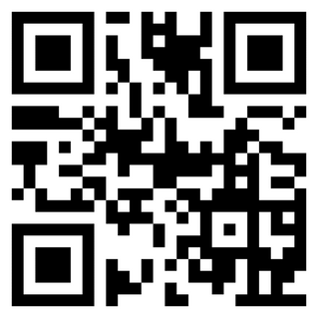
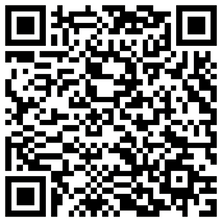
1 e-BOOK
Voice Over
Background Music
Audio book editing
2 AUDIO BOOK
Flip Book form & PDF
included on: https://perpustakaan.
mara.gov.my
7
E-Book
&
Audio
Book

Slide 23
Book testing
DASS-21 & DIDACTIC ANALYSIS
Conduct by MARA's Counsellor & Librarian
Using pre & post survey DASS-21 to test participants level of stress
Analysis found it has significant to reduce the level of stress, 17.1% Stress, 14.2% Anxiety and 2.9% Depression
Didactic Analysis for the book of Hikmah Saat Aku Diuji
earn 98% Consumer Satisfaction
8

Slide 24
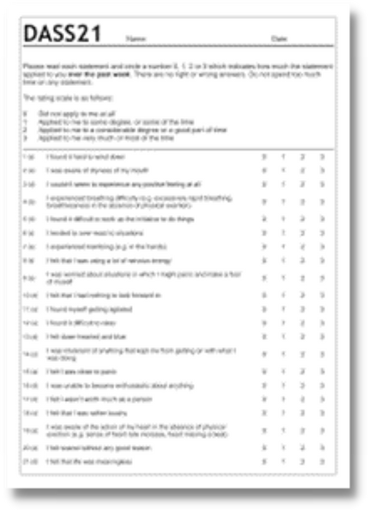
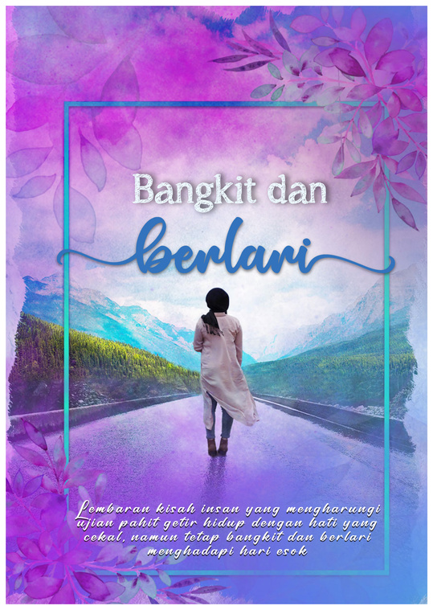
What is DASS?
DASS (Depression, Anxiety, Stress scale)
The DASS is a set of three self-report scales designed to measure the negative emotional states of depression, anxiety and stress. (WHO, 2021).
DASS-21 is developed by researchers Lovibond and Lovibond at the University of New South Wales, the Depression Anxiety Stress Scale is a well-established, self administered instruments with 21 statements that help people define, understand, and measure clinically significant emotional states.

Slide 25
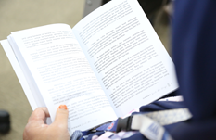
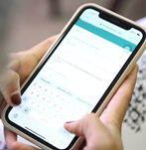
METHOD - PROTOTYPE TESTING
The book testing workshop was held on August 4th, 2022 (Thursday) from 8:00 am to
2:00 pm and was guided by MARA counceler,Dr. Salpiah binti Suradi with samples of 35 staffs at the MARA headquarters.
The samples used the Bibliotherapy book as reading material and therapy for 2 hours, then they have to answer Dass 2l inventory questionnaires for testing and quantitative data collection.

Slide 26
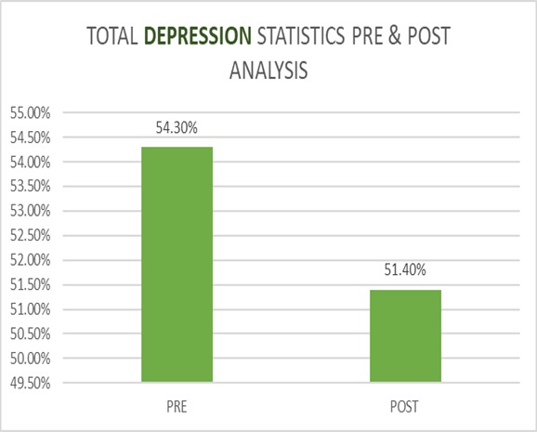
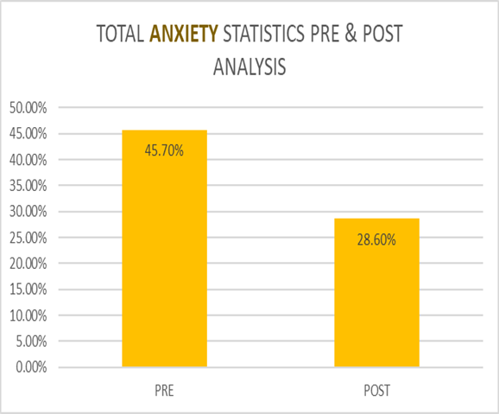
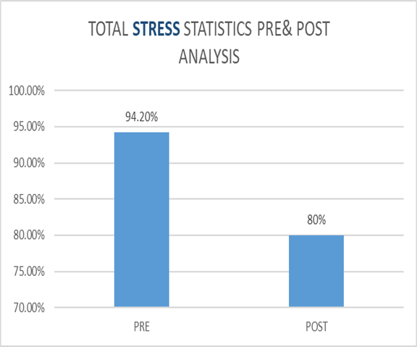
RESULTS
Depression level reduced 2.9% from 54.3% to 51.4% Anxiety level reduced 17.1% from 45.7% to 28.6% Stress level reduced 14.2% from 94.2% to 80.0%

Slide 27
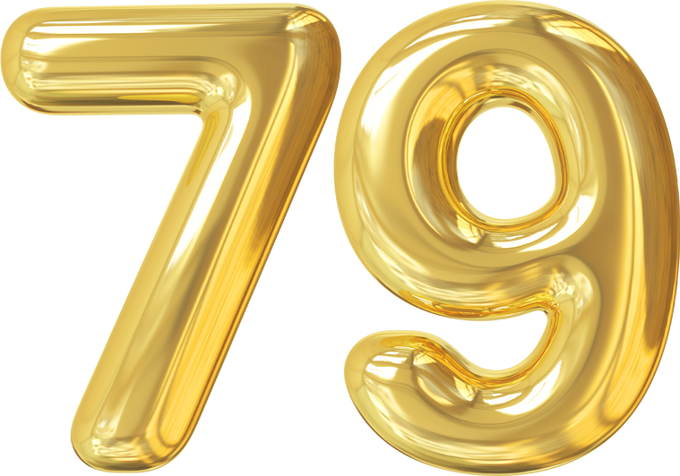
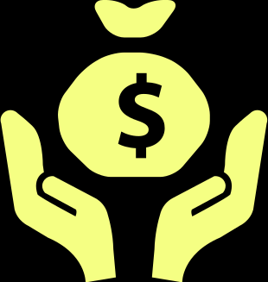
COST SAVING PROGRAM
COUNSELING TRAINING AND BIBLIOTHERAPY PROGRAM
ITEM | PROGRAM | BIBLIOTHERAPY PROGRAM
PROGRAM COST | RM83,255 | RM19,000
TOTAL TIME | 12 Months | 3 Months
TOTAL PARTICIPANT | 522 persons | 312 Persons
TOTAL PERSON INCHARGE | 4 persons | 4 persons
Bibliotherapy Cost
COUNSELING COST
PROGRAM
RM 19,000
RM 90,170
Great Saving with :-
PENGIRAAN KOS KAUNSELING
1) Program Intervensi Pegawai Prestasi
Rendah 2022 = RM1,650
2) Kursus Pengurusan Prestasi = RM500
3) Kursus Kembara Rohani 1 = RM11,680
4) Kursus Kembara Rohani 2 = RM5,745
5) Jelajah Kaunseling = RM12,800
6) Kursus Kaunseling Komuniti =RM12, 800
7) Bengkel Konseptualisasi Kes Kaunseling : Kaunselor MARA
= RM 17,400.00
8) Kursus Peningkatan Kompetensi Kaunselor dalam teori
Kaunseling solution focused brief theraphy = RM 12,800.00
9) Bengkel strategi kaunseling motivational interviewing
untuk kaunselor KKTM, MIJI, IKM = RM 15,950.00
JUMLAH KESELURUHAN : RM 247,925.00
PENGIRAAN KOS BIBLIOTERAPI
1) Bengkel Penulisan Biblioterapi = RM8,500
2) Bengkel Pemantapan Penulisan & Editing
3) Penerbitan Buku Biblioterapi = RM7,500
3) Bengkel Pengujian Buku Biblioterapi = RM3,000
RM8500 + RM7500 + RM 3000 = RM19,000
COST SAVING

Slide 28
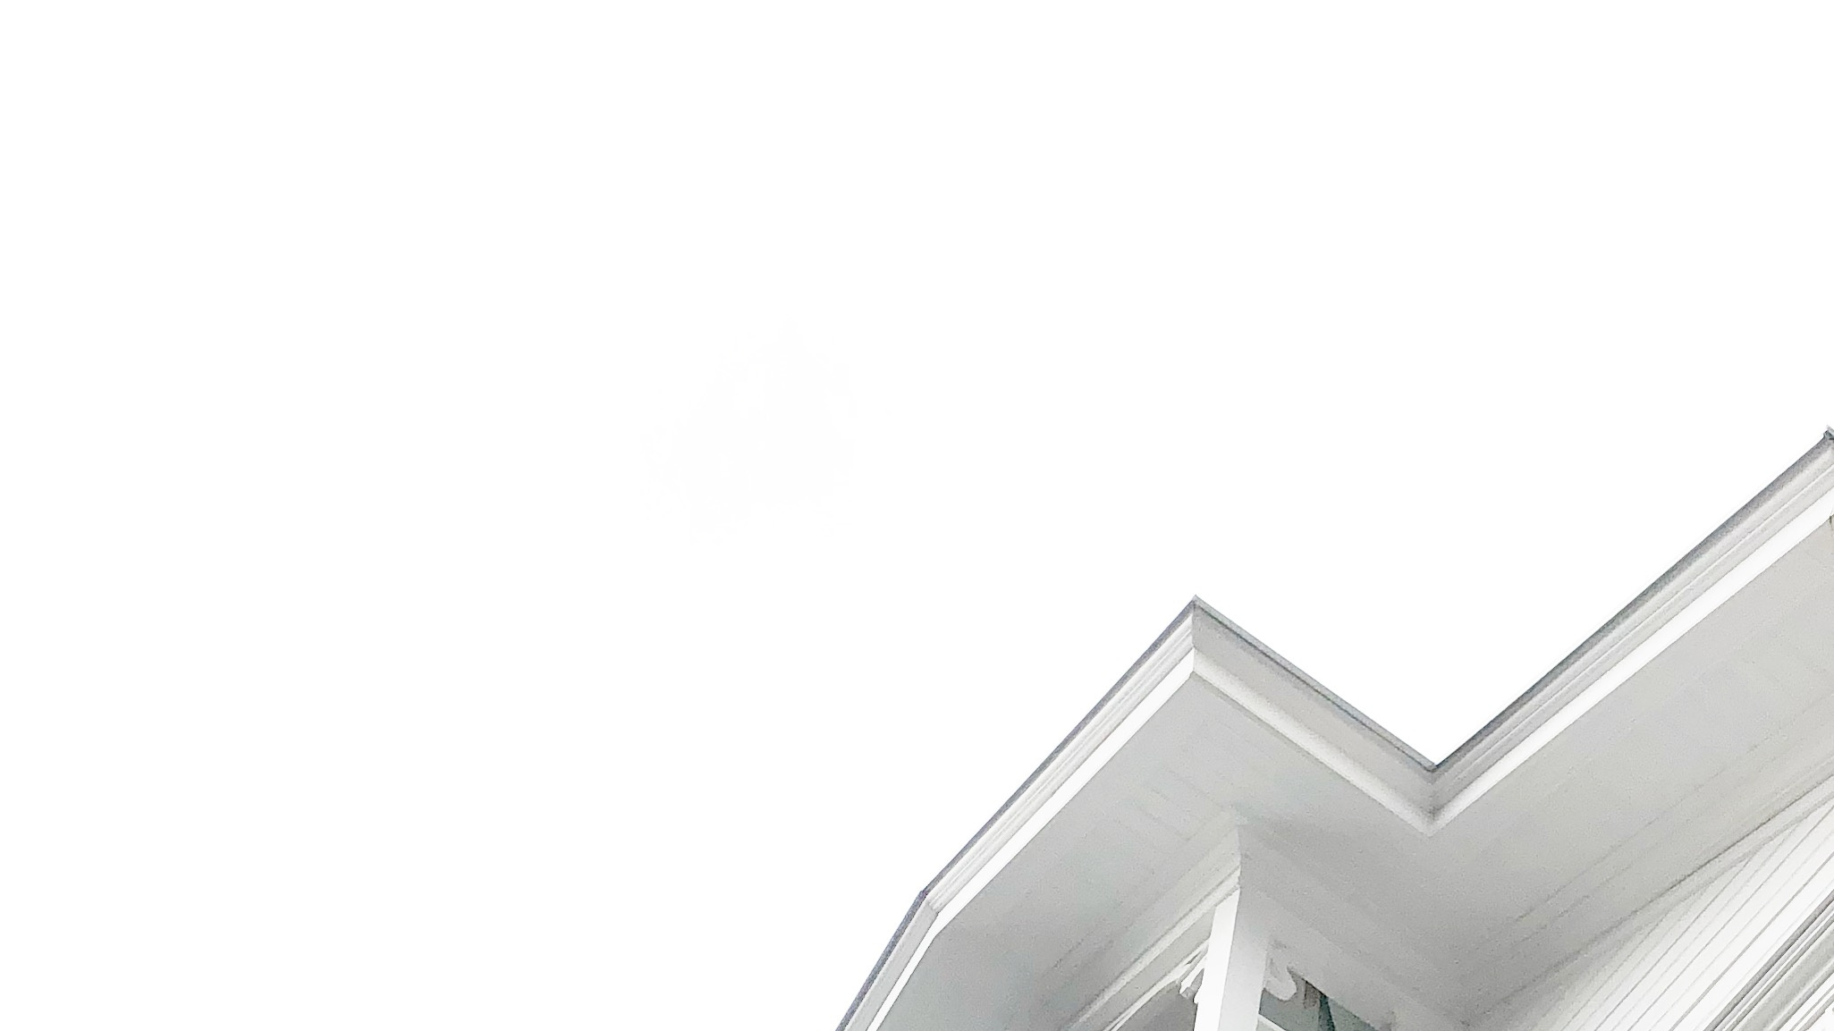
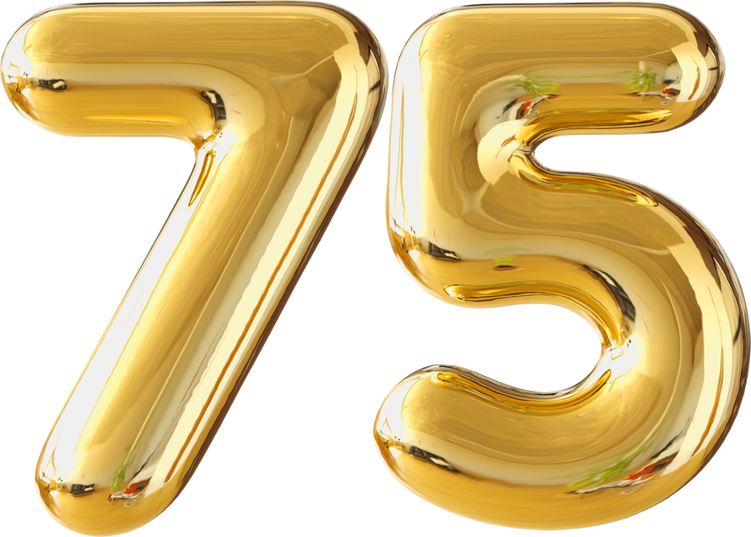
PROGRAM IMPLEMENTATION
PERIOD SAVING
COUNSELING PROGRAM
BIBLIOTHERAPY
PROGRAM
75 DAYS
22 DAYS
PROSES PELAKSANAAN PROGRAM PENGURUSAN EMOSI
1) Program Intervensi Pegawai Prestasi
Rendah 2022 = 60 Hari
2) Kursus Pengurusan Prestasi 2022 = 1 Hari
3) Kursus Kembara Rohani 1 = 2 Hari
4) Kursus Kembara Rohani 2 = 2 Hari
5) Jelajah Kaunseling = 1 Hari
6) Kursus Kaunseling Komuniti = 2 Hari
7) Bengkel Konseptualisasi Kes Kaunseling : Kaunselor MARA
= 3 Hari
8) Kursus Peningkatan Kompetensi Kaunselor dalam teori
Kaunseling solution focused brief theraphy = 1 Hari
9) Bengkel strategi kaunseling motivational interviewing
untuk kaunselor KKTM, MIJI, IKM = 3 Hari
75 Hari
LESS PERIOD UNTILL 75%
PROSES PELAKSANAAN PROGRAM BIBLIOTERAPI
1) Bengkel Penulisan Biblioterapi = 2 hari
2) Peserta menulis karya = 2 hari bekerja
3) Bengkel Pemantapan Penulisan 1 hari
4) Percetakan Buku Biblioterapi = 12 hari bekerja
5) Bengkel Pengujian Buku Biblioterapi = 1 hari
6) Rakaman Audio Book = 5 hari
22 hari
87

Slide 29
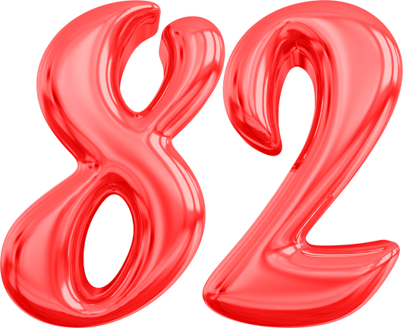
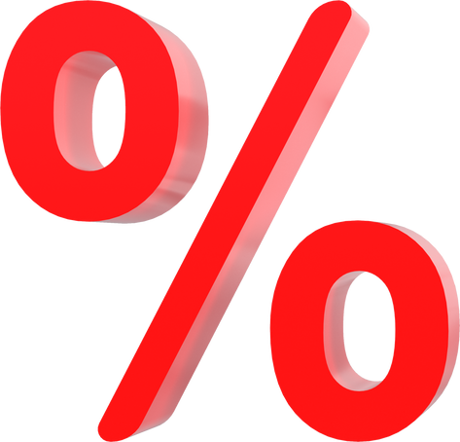
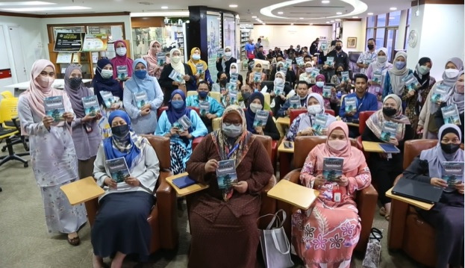
MANPOWER SAVING WITH:-
COUNSELING
PROGRAM
MANPOWER
413 PERSONS
PROGRAM
BIBLIOTHERAPY
MANPOWER
71 PERSONS
PROSES PELAKSANAAN PROGRAM PENGURUSAN EMOSI
1) Program Intervensi Pegawai Prestasi
Rendah 2022 = 4 orang
2) Kursus Pengurusan Prestasi 2022 = 4 orang
3) Kursus Kembara Rohani 1 = 121 orang
4) Kursus Kembara Rohani 2 = 56 orang
5) Jelajah Kaunseling = 30 orang
6) Kursus Kaunseling Komuniti = 24 orang
7) Bengkel Konseptualisasi Kes Kaunseling : Kaunselor MARA
= 27 orang
8) Kursus Peningkatan Kompetensi Kaunselor dalam teori
Kaunseling solution focused brief theraphy = 24 orang
9) Bengkel strategi kaunseling motivational interviewing
untuk kaunselor KKTM, MIJI, IKM = 35 orang
10) Program libat urus BSM bersama warga KPM Beranang
dan MJII = 88 orang
413 Orang
PROSES PELAKSANAAN PROJEK BIBLIOTERAPI
1) Bengkel Penulisan Biblioterapi = 8 orang
2) Peserta menulis karya = 15 orang
3) Bengkel Pemantapan Penulisan PIC yang sama
4) Percetakan Buku Biblioterapi = 5 orang
5) Bengkel Pengujian Buku Biblioterapi = 40 orang
6) Rakaman Audio Book = 3 orang
71 orang

Slide 30
DISCUSSIONS
•The research has proven that using tailored made Bibliotherapy book (Hikmah Saat Aku Diuji) can reduced the depression, anxiety and stress level among staff
Depression level reduced 2.9% from 54.3% to 51.4%
Anxiety level reduced 17.1% from 45.7% to 28.6%
Stress level reduced 14.2% from 94.2% to 80.0%
Operational cost reduced 79%
Manpower reduced 82.8%
Duration of program reduced 75%

Slide 31
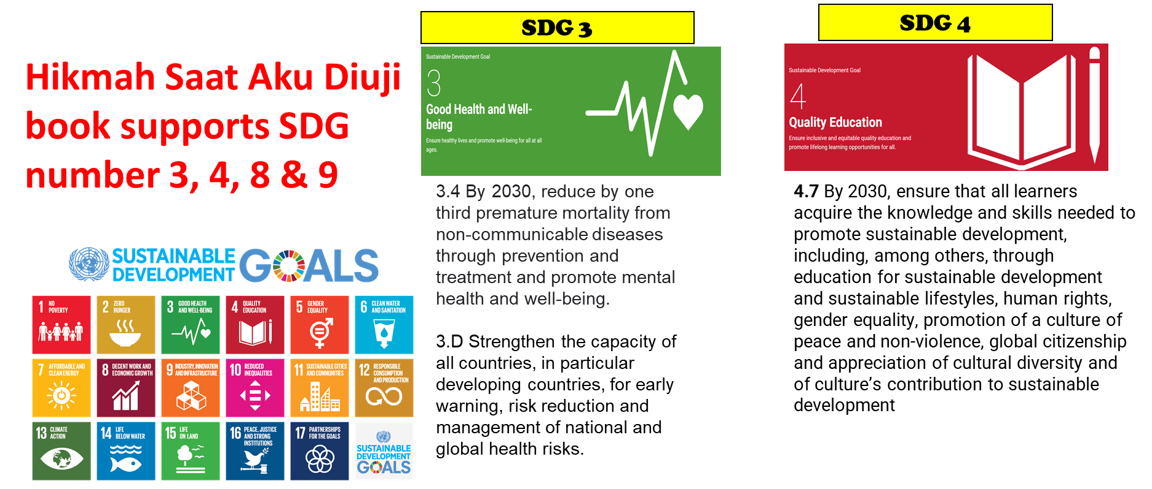
SUSTAINABLE DEVELOPMENT GOALS (SDG)
MARA Bibliotherapy project support SDG number 3,4,8 & 9

Slide 32
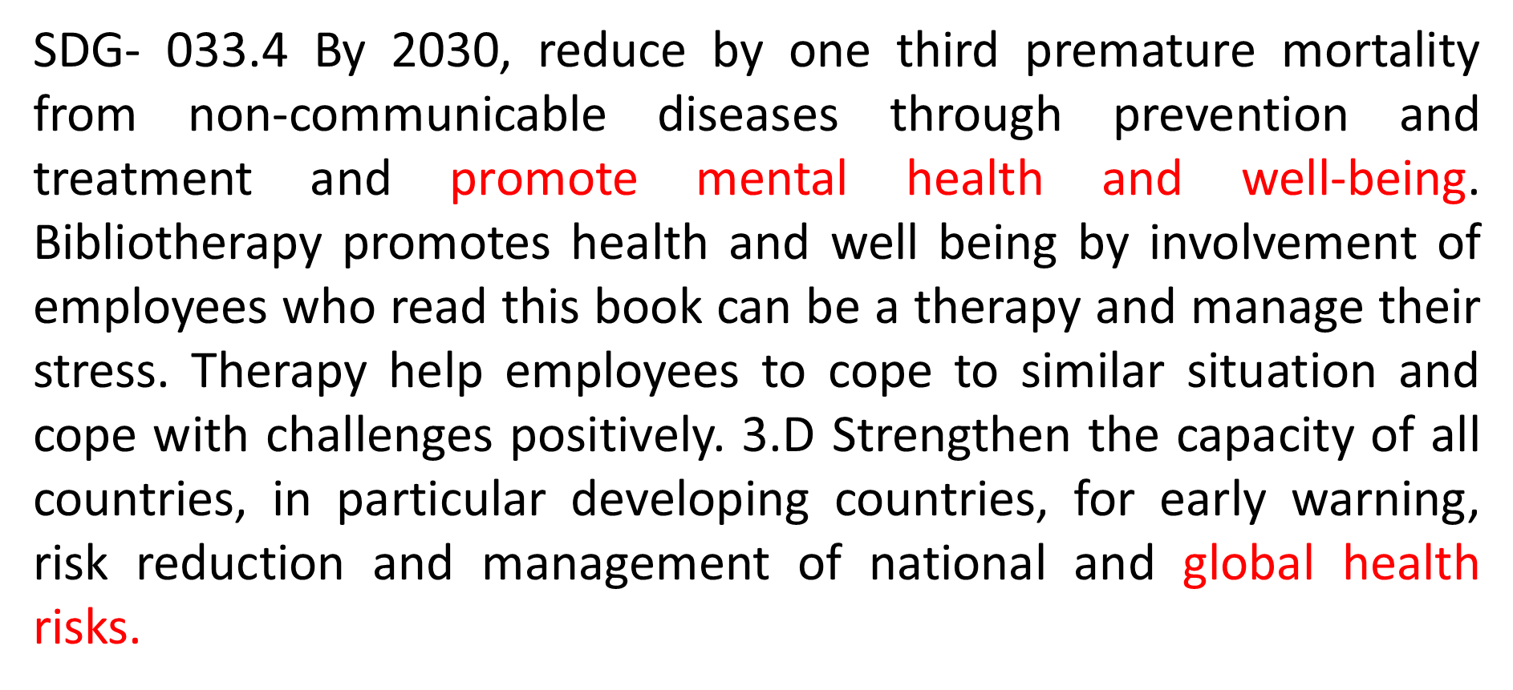

Slide 34
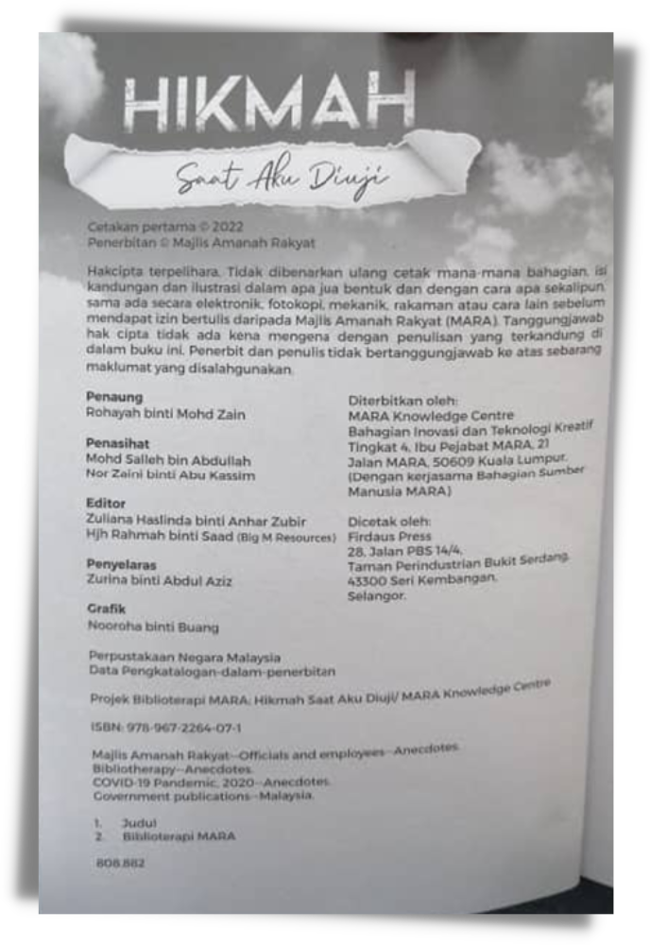
NOVELTY
MARA is the first organization in Malaysia to publish bibliotherapy books written by MARA staffs.
There is still no bibliotherapy technique used in any organization to reduce the level of early Depression (mild-depression), Anxiety (Anxiety) and Stress (Stress).
Bibliotherapy books are published in various formats such as e-books, audio books and printed materials

Slide 35
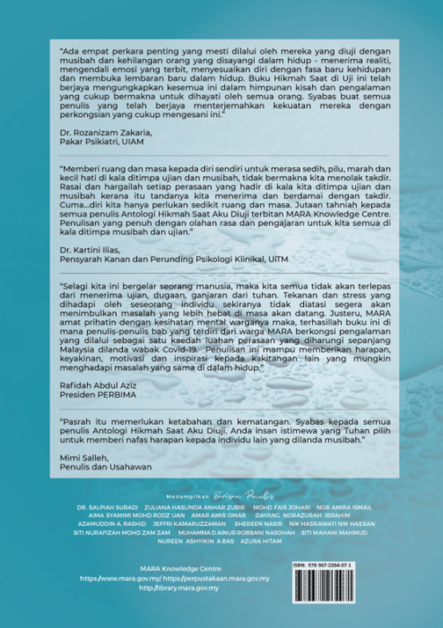
INTELECTUAL PROPERTY
ISBN:9789672264071
Copyright No: LY2023W00181

Slide 36
1 BIBLIOTHERAPY CORNER
Bibliotherapy Corner is designed with suitable furniture and color to create serene ambiance, inviting environment and equipped with bibliotherapy books collection by theme.
Bibliotherapy
Corner
9

Slide 37
REPLICATION
MARA's Instituitions Applied Bibliotherapy
•The bibliotherapy MARA was started in 2022 and our BT books was distributed to 90 libraries in MARA and few public sectors such as libraries in Ministry of Rural Development (KKDW), University Malaya, RISDA, DBKL, Malaysia National Library, BERNAMA, ppAS (Perbadanan Perpustakaan Awam Selangor) and UniKL.
Bibliotherapy Corner
at
Bibliotherapy Corner
at
Library of
KKTM Masjid Tanah
Library of
KPM Beranang
Bibliotherapy Corner
at
Library of
KPM Ayer Molek
MARA & BERNAMA

Slide 38
COMMERCIAL OPPORTUNITIES
Surprisingly there are demands for our Bibliotherapy book to be used by other agencies.
We have sold this Hikmah Saat Aku Diuji books for RM 35.00 per copy.
200 units are sold in 2022.
Sold 200 units

Slide 39
"Bangkit dan berlari" is our 2nd Bibliotherapy book publications and received positive feedbacks.
This book is RM 35 per copy
Sold 200 units

Slide 40
Exhibition on
Ministry of Rural & Regional Development (KKDW)
Counseling Month
in Putrajaya
Exhibition on
MARA Counseling Month
in the Headquarters
Congratulations to MARA for producing innovative products which can help people...
Interesting book and really worth it...
Dr. Malar Santhi
Peg. Perubatan Hospital Columbia
Dato' Seri Ramlan bin Harun
KSU KPLB
Market potential outside MARA
I have bought this book, it's worth it..?
Sold 110 units
Bernama, UM, UKM, KKDW, PPAS, PNM, DBKL, RISDA, Ketengah, Kesedar etc.

Slide 41
TRL
(Tecnology Readiness Level)
• TRL of this innovation product is 9 because the book has already been tested and approved at real environment. This book has been distributed to 90 MARA Education Institutions and can be used by librarian and counselor using DASS-21 to detect depression, anxiety and stress level. The book is used as treatment to reduce depression, anxiety and stress level because it consist of 3 phase of bibliotherapy writing (identification, chatarsis and insight).

Slide 42
ACCREDITATION BY AGENCIES

Slide 43
COLLABORATION
10
UiTM
UIAM
UKM
BERNAMA
PEKAMARA
AKRAB
BIG M
Konsultan yang berpengalaman dalam bidang penulisan

Slide 44
COLLABORATION WITH UKM
For advice on Bibliotherapy techniques
Prof. Madya Dr Ku Suhaila Ku Johari
Coordinator Creative Writing (Bibliotherapy)
UNIVERSITI KEBANGSAAN MALAYSIA (UKM)

Slide 45
MARKET SURVEY POTENTIAL
Market survey carried out around Klang Valley shows that there is demand for Healing Books:
74.5% respondents willing to pay RM35.00 for a bibliotherapy physical book
32% respondents willing to pay RM20.00 for audio Bibliotherapy book
53% respondents willing to pay RM35.00 for bibliotherapy e-book
Along with the survey done, we had a market test for the book and surprisingly we managed to sell 400 copies for Bibliotherapy book 1 and Bibliotherapy book 2 with the price off RM150.00 for printed book, audio book and e-book. Gross profit reached to RM20,000.

Slide 46
GOLD Award MINISTRY OF RURAL AND REGIONAL DEVELOPMENT
(KKDW)
Gold award MTE SDG 2022
2 Stars accreditation award Innovation& Creative Circle ICC Malaysia- way to Beijing
5 GOLDS AWARDS
in 2022
Gold award Mentor Menti program MARA

Slide 47
Gold award i-MARATeCH 2022
2 Stars accreditation award Innovation& Creative Circle ICC Malaysia- way to Beijing
5 GOLD AWARDS
in 2022
GOLD Award MINISTRY OF RURAL AND REGIONAL DEVELOPMENT
(KKDW)
Gold award Mentor Menti program
Gold award MTE SDG 2022

Slide 49
TESTIMONIES
This book was recognised by prominent person:
Dr. Rozanizam Zakaria, Psychiatrist UIAM
Dr. Kartini Ilias, Clinical Psychologist UiTM
Mimi Salleh, writer and entrepreneur

Slide 50
The short story anthology 'Bangkit & Berlari' really caught my attention. The sharing of stories and experiences of the writers had an effective impact on my psychology. Surely to readers who have the same story and experience, the story will lead to a positive psychological effect because every story has a good ending. This will give hope to readers who are experiencing trials in their lives. Appreciation and confidence that every difficulty must have a facility to overcome the problem produces peace of mind and emotions of the reader. Readers also have the opportunity to understand the heart and feelings of each writer and their methods of dealing with the trials experienced. This kind of storytelling is therapy for readers who have always thought they were the only ones with problems. Congratulations to the writers who have the courage to talk about their privacy.
Dr. Mohammad A.R
UniKL RCMP Psychiatrist

Slide 51
APPROVAL OF THE EFFECTIVENESS AND STANDARDIZATION OF THE LIBRARY THERAPY PROGRAM THROUGHOUT THE MARA CENTER

