Slide 1
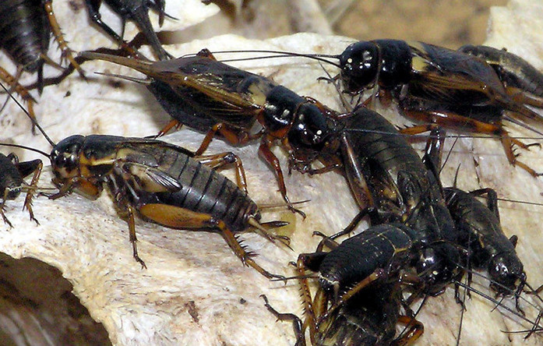
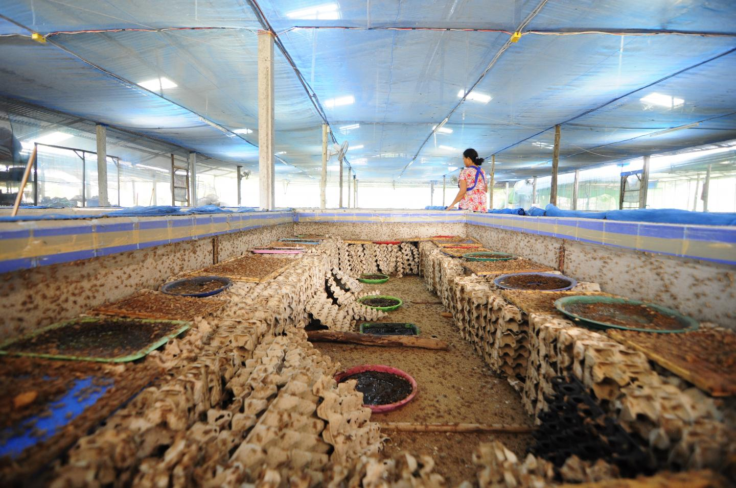
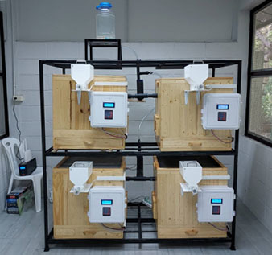
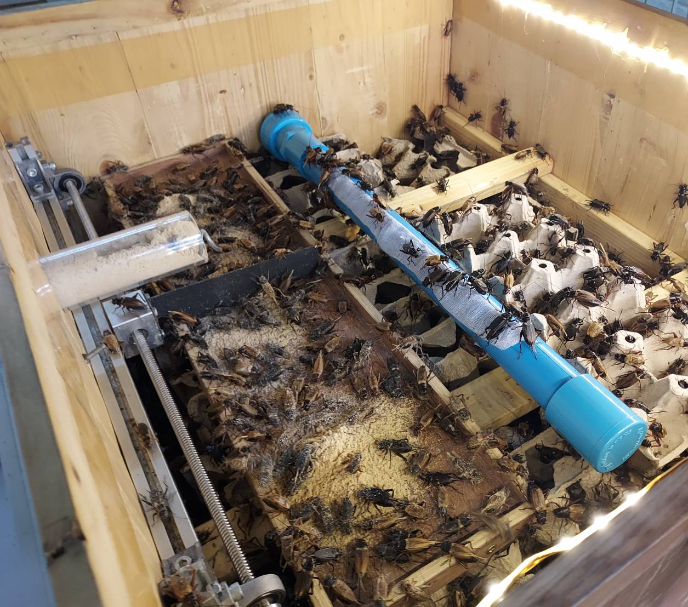
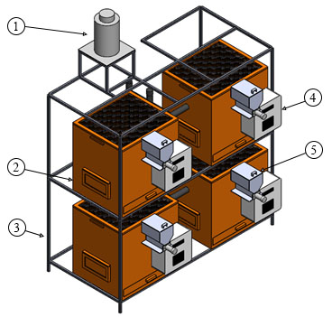
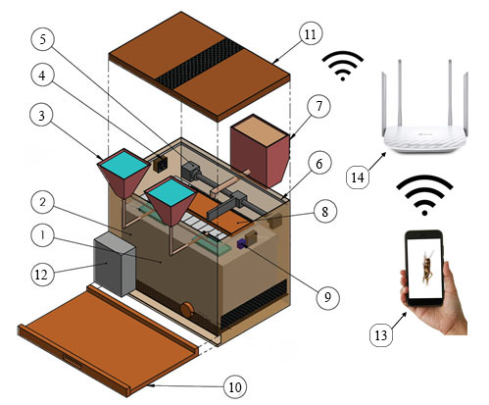
Automatic Cricket Feeder
Piyapong SRIWONGRAS¹, Chama INSON², Supakit Sayasoonthorn¹, Thanakorn Promkhoka¹
Department of Farm Mechanics, Faculty of Agriculture, Kasetsart University, Thailand.
2. Department of Entomology, Faculty of Agriculture, Kasetsart University, Thailand.
Abstract
This research aims to develop a cricket farming system using smart technology to assist cricket farming in order to reduce labour problems and use the space to raise crickets effectively. As a result of the development of the system, the researchers applied microcontroller technology with the Internet of Things (IOT) system for automatic feeding and water control of cricket’s feeding. 1,600 Two-spotted crickets (Gryllus Bimaculatus Degeer) were selected to be raised in the experiment with the developed and the tradition systems. According to the result of experiment, it was found that the developed system had survival rate of cricket higher than that of a conventional method. Also, the cricket yield getting from developed system was higher than a traditional method. Therefore, using the developed system for feeding crickets is able to increase productivity of cricket compared to raise cricket with conventional method and reduce man-hour for operating in a cricket farm.
Introduction
Results
Cricket is economic insects that are popularly cultivated by Thai farmers for selling. Nowadays, in Thailand, farmers have mostly raised cricket in open environment with a simple chamber built for the crickets. Cricket farming is one of rare agricultural industries that has developed rapidly and largely.
After 25 days of raising crickets with both types of cricket feeding, the results were shown in a below table. From the table, it was found that Feeding crickets in a conventional box and automatic box after experimental period. The numbers of crickets after rearing were 210 and 276 and survival rates of cricket were 26.25% and 34.5%, and total weight of crickets after rearing of the conventional and automatic boxes were 140.7 g and 237.4. g respectively.
Crickets
Traditional cricket farming
Material and methods
The methodology of the research was divided into three section as followings;
Design and fabricating of an automatic cricket feeder
The developed cricket feeder was designed to be 65 cm wide, 63 cm high, 55 cm long. The cricket feeder was equipped with an automatic feeding and watering systems. Farmers can press the feeding and watering button for the crickets through the control panel locating in front of the cricket feeder box, or control the system via mobile phone.
2. Test of automatic cricket feeder
4 cricket feeders placed in a structure
View inside the developed cricket feeder
Study factors | Conventional cricket feeding | Automatic cricket feeder
1. The number of crickets before rearing | 800 | 800
2. The number of crickets after rearing | 210 | 276
3. Survival rate (%) | 26.25% | 34.5%
4. Total weight of crickets before feeding | 61.5 g | 59.55 g
5. Total weight of crickets after rearing | 140.7 g | 237.4 g
The experiment started from the researcher using an developed automatic cricket feeder to be tested compared with a conventional cricket box without automatic feeding system. The cricket-feeding box of both experiments were similar dimension. 1,600 two-spotted crickets with 2 weeks old were used in the experiment. 800 crickets were reared in automatic cricket feeder, and others were reared in conventional method.
Conclusion
The automatic cricket feeder developed in the project is the novel machine for rearing the cricket farming with higher survival rate of cricket when compared with traditional cricket feeding.
The automatic feeder can save the operating time of farmers for feeding crickets and reduce the labor in feeding process for crickets
Model of an automatic cricket feeder
Elements of an automatic cricket feeder
Reference
VINEETH, S. – RENUKUMAR, B R – SNEHA, V C – GANJIHAL, P. - RANI B. 2020. Automatic Pet Food Dispenser using Digital Image Processing. In International Journal of Engineering Research & Technology (IJERT), vol.9, no.5, pp. 588-593.
Acknowledgement
This research has been supported by “Kasetsart University Research and Development Institute (KURDI), (Grant No. FF(KU) 7.64)”.

