Slide 1


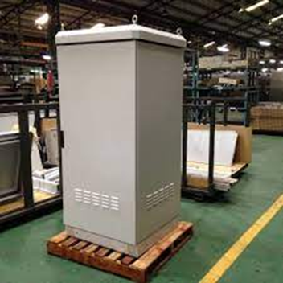
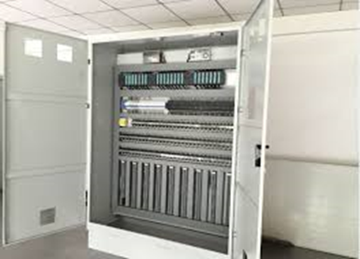
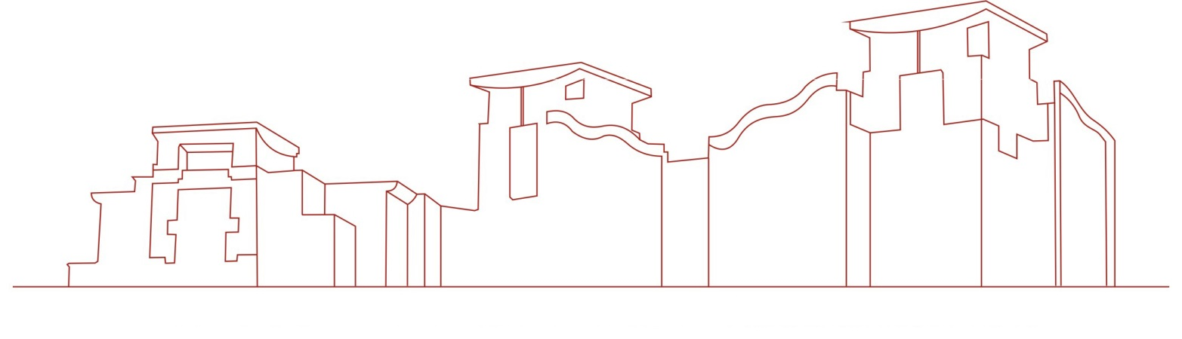
Electric Dustproof Power Cabinet
This creation system provides an electric dust-proof power cabinet. By setting the observation port, the internal conditions of the cabinet can be better observed, which is convenient for the staff. By setting the handle and the lock hole, the cabinet door can be better controlled and protected. Function, by setting the shock absorber, it can better protect the hair dryer and increase the stability of the hair dryer. By setting the support rod and the bottom plate, the cabinet can be supported and fixed, and the stability of the cabinet can be enhanced.

