Slide 1
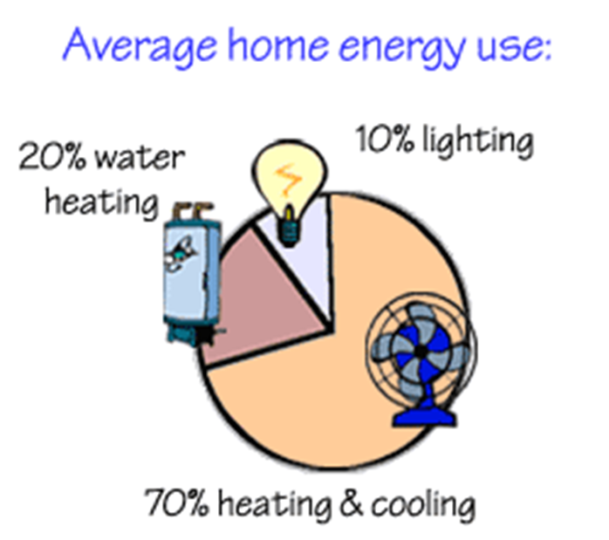
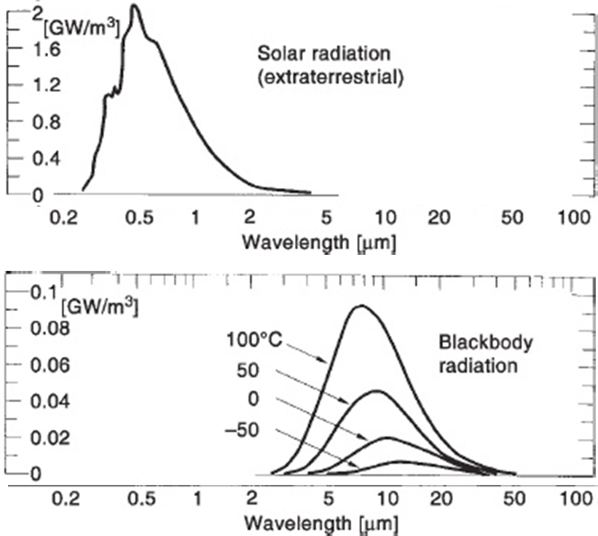
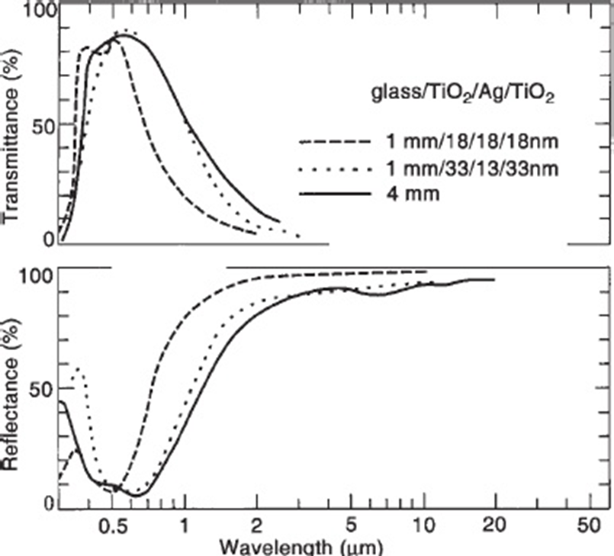
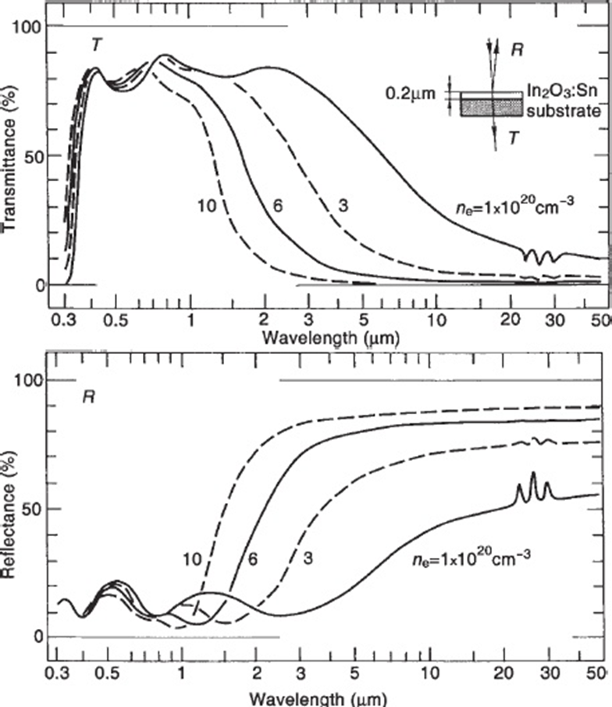
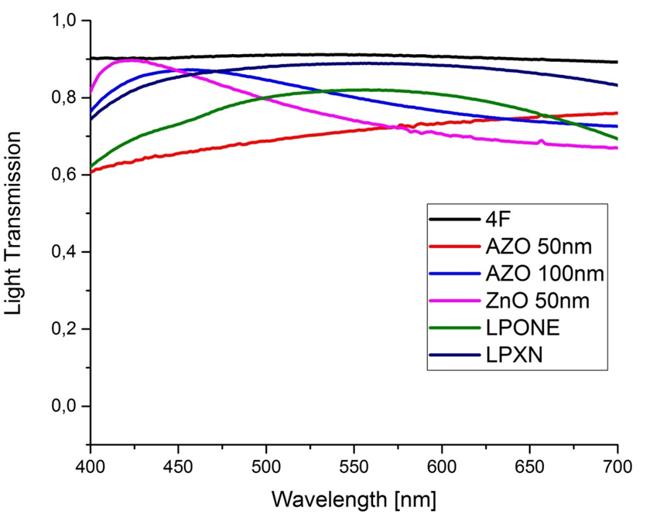
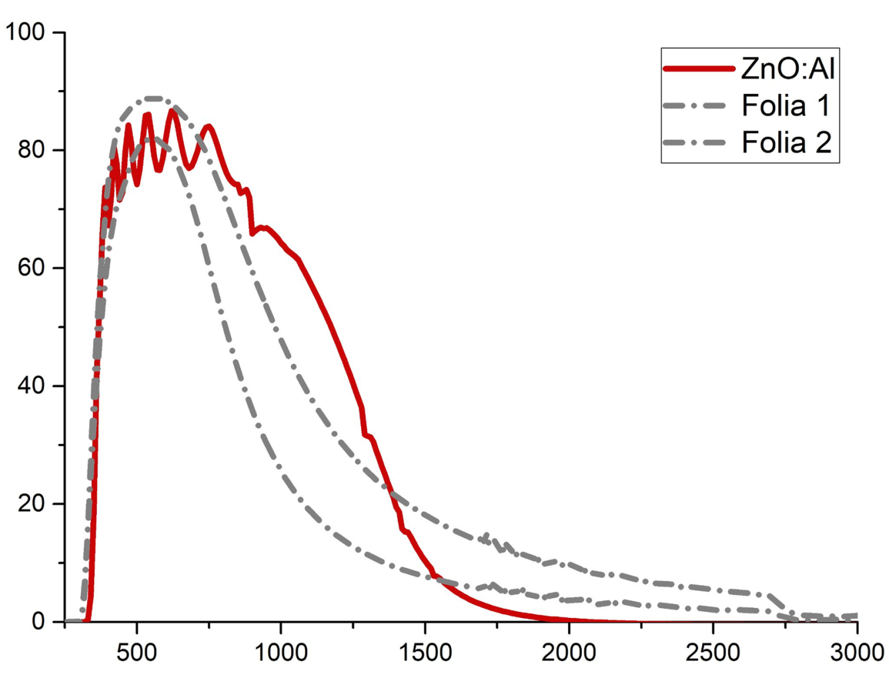
Oxide layers deposited by the ALD method as heat-blocking
coatings for windows
Bartłomiej S. Witkowski, Aleksandra Seweryn, Piotr Sybilski, Marek Godlewski
Institute of Physics Polish Academy of Sciences, Al. Lotników 32/46, 02-668 Warsaw, Poland
MOTIVATION
Global warming - The mechanism by which rising carbon dioxide levels cause global climate change has long been well understood. CO₂ is a greenhouse gas and its higher concentration increases the absorption of infrared radiation and enhances the greenhouse effect. Studies show that at the current concentration (over 400 ppm) it is strengthened by about 2 W / m² compared to the state before the beginning of the industrial era. To survive we must reduce significantly energy consumption and introduce „green” energy sources.
PROBLEM TO SOLVE
SOLAR ENERGY DISTRIBUTION
Only part of solar radiation is useful for us (so-called visible light). Window should transmit only the visible light.
Long-wave radiation (infrared) generates only heat.
From black body radiation we can estimate infrared radiation responsible for heat escape from our homes in winter.
To reduce heat escape we should introduce glass coatings blocking part of ir radiation.
Buildings (home use) - About 70 % of the electricity we use for heating or cooling. We can save a lot of energy by improving isolation of our homes.
CONCEPT of e-LOW WINDOWS
Metal coatings (e.g. Ag) are used in e-low windows. They must be protected by coating with some thin films or a special construction of windows – inner part is coated and window is filled with a neutral gas e.g. argon).
Metal coatings can be replaced by thin films of transparent conductive oxides.
Transparent Conducting Films
Between metals and dielectrics is an interesting class of materials known as transparent conductors (TC). The most useful materials are In₂O₃:Sn (ITO), SnO₂:F, SnO₂:Sb, and ZnO:Al. ZnO:Al (AZO) is the cheapest option.
RESULTS OF FIRST TESTS
The reference glass (4F) has a visible light transmission of 90%. The commercial XN coating is closest to this value - glass with this coating has a transmission of 85%. The ZnO 50nm (A), AZO layer of 50nm (B) and AZO 100nm (C) layers are characterized by a transmission of about 80%, with differences depending on the color of the light.
For e-low coatings, two spectral ranges are important: 700 - 4500 nm and the range 8-12 µm (the atmosphere transmission window responsible for the so-called catastrophic heat leakage). In the second spectral range, all tested coatings, including the reference glass, completely block the transmission of radiation. Even very thin AZO and ZnO layers cause a significant decrease in transmission in the first spectral range.
CONCLUSION
Even though, the ALD process of AZO deposition still requires optimization and selection of the correct thickness of deposited films, but the first results are very encouraging . The research partly financed by „Inkubator Innowacyjności 4.0” project granted by Ministry of Science and Higher Education (MNiSW).
CONTACT PERSON:
Prof. dr hab. Marek Godlewski
godlew@ifpan.edu.pl

