Slide 1

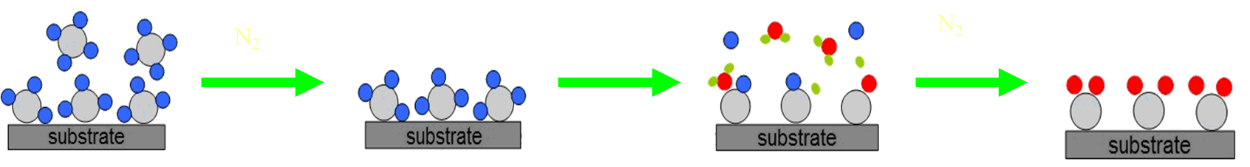
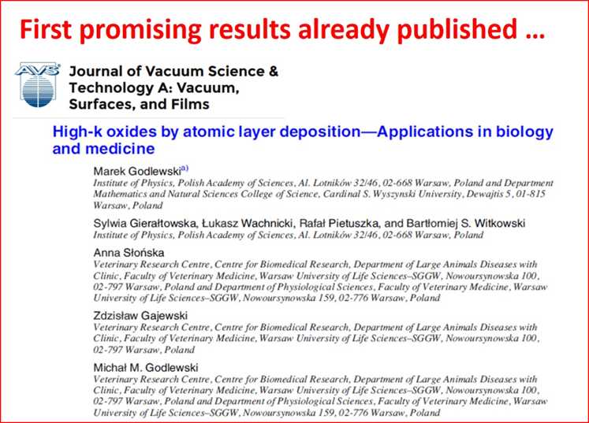
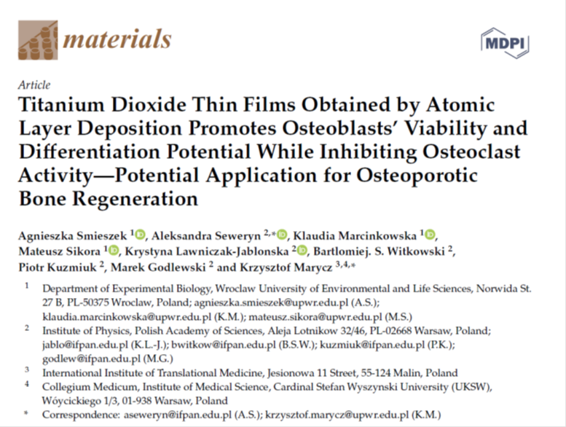
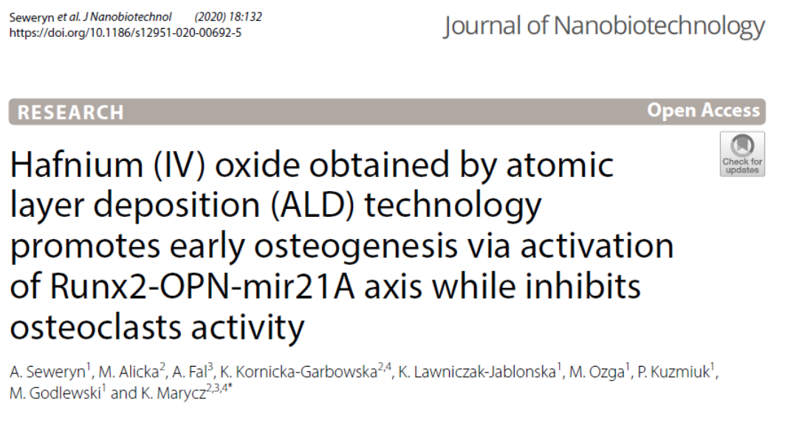
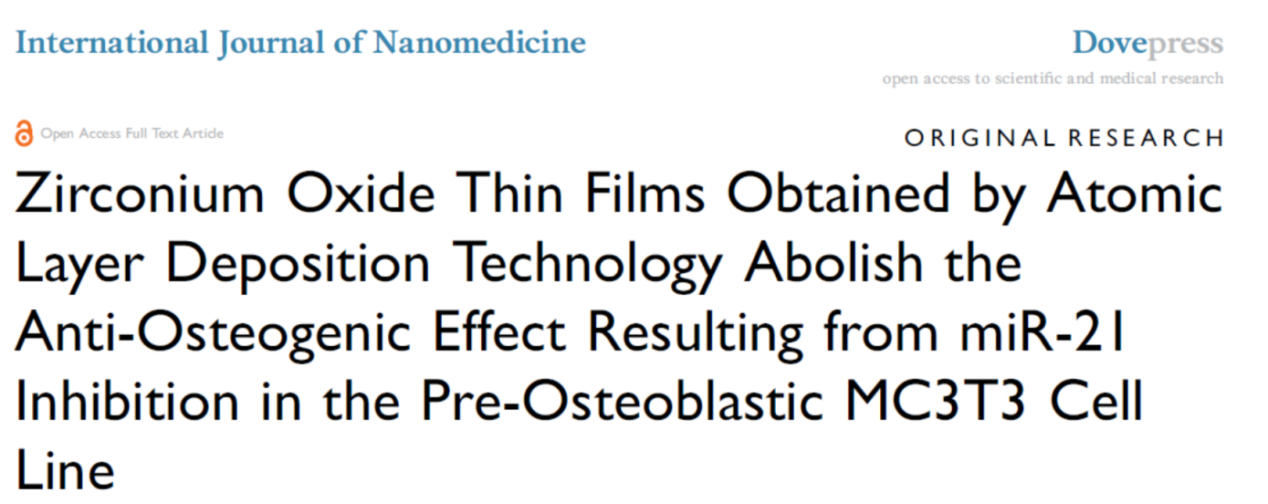
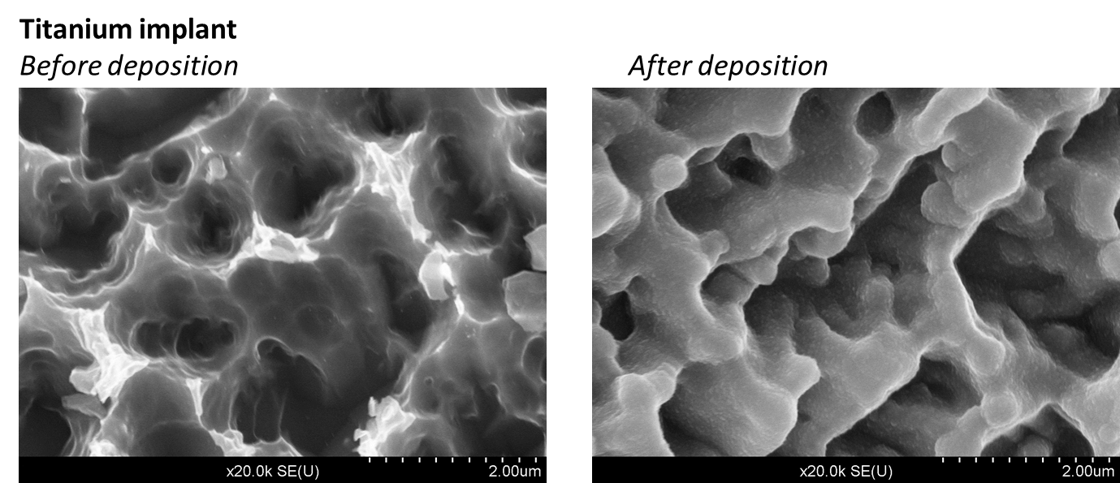
Oxide layers for applications in dentistry and implantology
Aleksandra Seweryn, Bartłomiej S. Witkowski, Marek Godlewski
Institute of Physics Polish Academy of Sciences, Al. Lotników 32/46, 02-668 Warsaw, Poland
MOTIVATION
Osteoporosis (OP), which becomes more common with age, is a civilization disease. It is more common in women than men. In the developed world, depending on the method of diagnosis, 2% to 8% of males and 9% to 38% of females are affected. For example, about 22 million women and 5.5 million men in the European Union had osteoporosis in 2010. The analogous data for the United States (in 2010) are as follows - about 8 million women and between 1 to 2 million men had osteoporosis. In the United States of America, costs of OP-related fractures is estimated to $13.8 billion.
IMPLANTS
ALD Growth method
Treatment with bone implants is often required in osteoporosis patients with low osteogenic potential.
Correct integration of the implant with the bone tissue determines the success of bone scaffold implantation.
Problems:
1) Tissue transplants and implants face a major threat on contamination by microbes – antibacterial coatings, antibiotics
2) Metals are toxic – expensive Ti implants are used
3) Metals diffusion – barrier layers
To minimize post-treatment problems implants should be coated. We developed A new ALD-based technology to deposit multi-purpose coatings of implants.
ALD (Atomic layer Deposition) technology consists in a sequential distribution of chemical compounds in a gas phase into the reaction chamber. Each precursor pulse is separated with a purge phase of the chamber, whereby the precursors don't react with each other in the gas phase. The reaction occurs only on the substrate. One precursor pulse corresponds to the deposition of one atomic monolayer on the substrate. Therefore, the ALD is characterized by precise thickness control.
ALD technology enables the deposition of homogeneous transition metal oxide thin films on the complex substrates.
MATERIALS SELECTION
We tested the oxides of transition metals for their anti-bacterial activity and biocompatibility with osteo-cells. Based on these investigations we have selected zirconium dioxide, hafnium dioxide and titanium dioxide, obtained by ALD technology, as coating materials.
We studied the development of bone marrow stromal cells in contact with the ALD layers and observed different behavior of such cells in relation to different oxides.
Zirconium
dioxide
Hafnium
dioxide
Titanium
dioxide
RESULTS
APPLICATIONS IN DENTISTRY
Zirconium dioxide improves mitochondrial metabolism of bone forming cells. Titanium dioxide decreases invasion of osteoclast cells. Hafnium dioxide increases expression of bone markers, including transcription factor Runx-2.
Our technology enables conformal deposition of amorphous ZrO₂ layer, well adhering to the substrate and tightly separating the implant material from the biological environment. Since ZrO₂ is already used in dentistry. Thus, Ti tooth implant coating with ZrO₂ is the most likely the first application of our technology.
What’s next?
We have 1 Polish patent application (433753) protecting our results. Selected results soon be ready for commercialization. The research partly financed by „Inkubator Innowacyjności 4.0” project granted by Ministry of Science and Higher Education (MNiSW).
CONTACT PERSON:
Prof. dr hab. Marek Godlewski
godlew@ifpan.edu.pl

